Slide 1














ThoughtSpot DataFlow and Data Loading
Version 6.3
© ThoughtSpot Inc 2019

Slide 2
Learning Objectives
Use DataFlow to load data directly form external data source
Learn how to work with a new dataset
Prepare data for loading
Learn how ThoughtSpot handles complex schemas
Create a schema
Load data (tsload)
Notes:
This is a hands-on session which will require participants to have a computer with Internet access, a web browser, terminal emulator, and SCP client. A basic understanding of SQL and Linux is helpful. In this session, you will learn how to load data into ThoughtSpot’s high speed in-memory database, as well as options to use ThoughtSpot on external databases or data warehouses.

Slide 3
Introduction

Slide 4
ThoughtSpot Instances
If you can't access your ThoughtSpot instance, it is likely because of the security policy on your laptop.
Try this URL instead, substituting your IP where shown, and using hyphens as in the sample:
ec2-13-57-76-215.us-west-1.compute.amazonaws.com

Slide 5
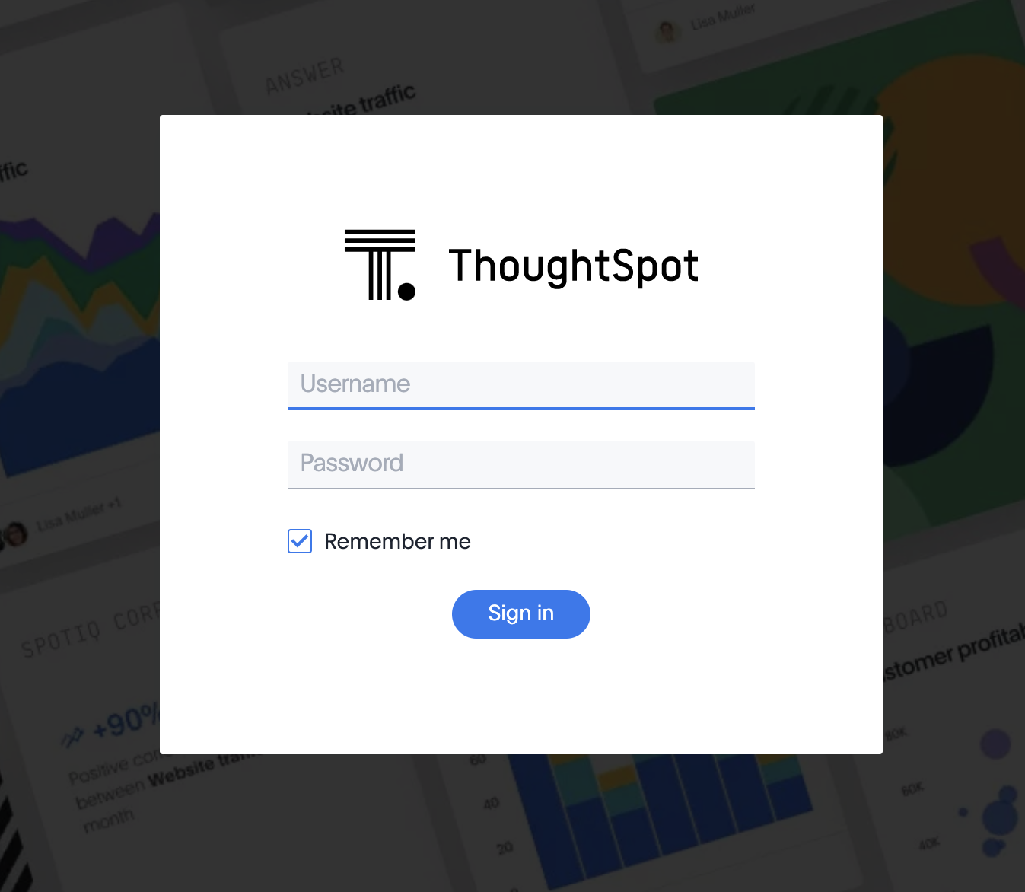
Log In

Slide 6

Finding a Good Use Case
Success using ThoughtSpot starts with identifying an appropriate use case.
What makes a good use case?
Metrics that can provide actionable insights and measure business improvement over time
Questions asked of the data are variable, and change over time (not addressed by a static report)
Large addressable audience
Large data volume with need for granular data
Relational data that is modeled for analytical use

Slide 7












Integrated Architecture
RELATIONAL
SEARCH
PINBOARDS
EMBEDDED & APIS
AUTOMATED INSIGHTS
MOBILE
BUSINESS MONITORING
INSIGHTS
FEED
SEARCH ENGINE
SPOTIQ AI ENGINE
PERSONALIZATION ENGINE
DISTRIBUTED CLUSTER MANAGER
ENTERPRISE SECURITY &
GOVERNANCE
BI & VISUALIZATION SERVER
IN-MEMORY CACHE
EMBRACE - LIVE QUERY
DATA LOAD
On-prem EDW & DB
Data Lake
Apps (Salesforce, Marketo, etc.)
CSVs
Built from the ground up for search, designed for flexibility

Slide 8
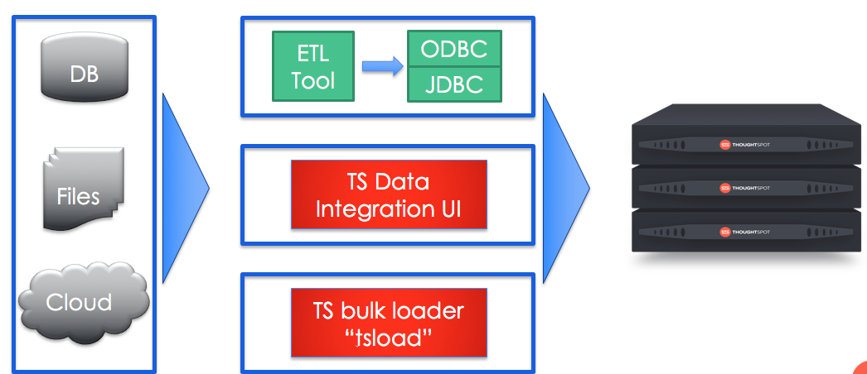
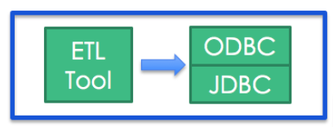
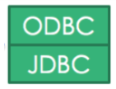
Data Loading (Caching)

Slide 9
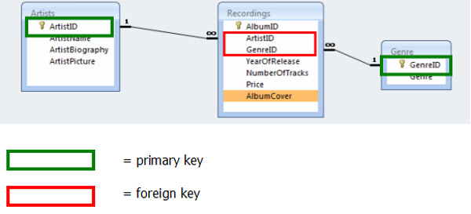
Constraint: Primary Key
Uniquely identifies a row
Can be multiple columns

Slide 10
Constraint: Foreign Key
Used to define JOIN relationships.
Must match the primary key in the table it is joining to
Directionality matters: Defined on the fact table
Hint: Create tables first in your DDL script, and then use ALTER TABLE to add Foreign Key relationships.

Slide 11
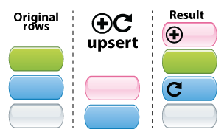
How a Primary Key Impacts Data Loading Behavior
When a new row is added, ThoughtSpot does an “upsert”:
UPDATE: If another row already exists with the same primary key, it is updated with the values in the new row.
INSERT: If a row with the same primary key does not exist already, the new row is inserted into the table.

Slide 12
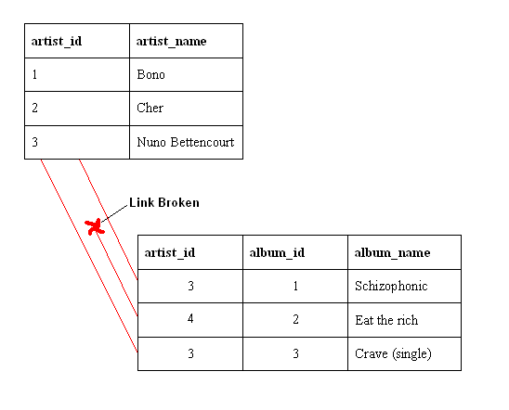
How ThoughtSpot Differs from Transactional Databases (OLTP)
Optimized for reads (avoid using INSERT, UPDATE)
Primary Key
No enforcement of unique constraints during insertion or deletion.
Foreign Keys
No validation of referential integrity.

Slide 13
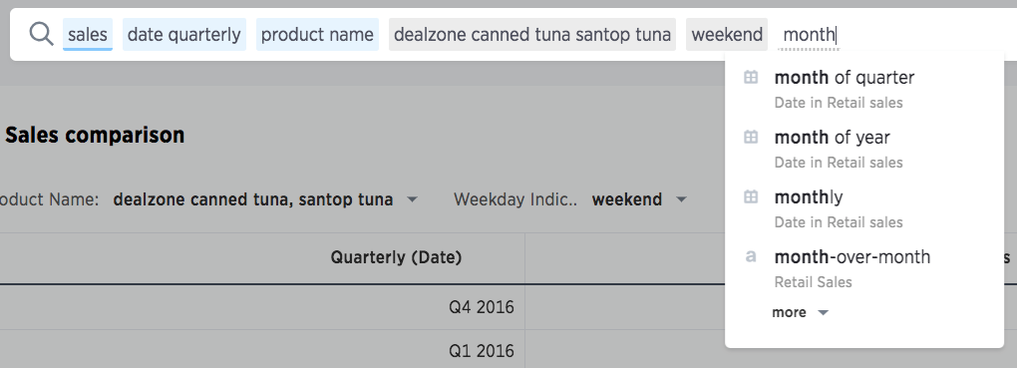
Date Dimensions
Remove unnecessary columns that conflict with ThoughSpot search keywords (day of week, day of month, is weekend)
Use your formulas

Slide 14
Supported Data Types
Kind of data | Supported data types | Details
Character | VARCHAR(n) | Specify the maximum number of characters, as in VARCHAR(255). The size limit is 64 MB for VARCHAR values.
Floating point | DOUBLE FLOAT | DOUBLE is recommended.
Boolean | BOOL | Can be true/false, T/F, or 1/0.
Integer | INT BIGINT | INT holds 32 bits. BIGINT holds 64 bits.
Date or time | DATE DATETIME TIMESTAMP TIME | DATETIME, TIMESTAMP, AND TIME are stored at the granularity of seconds. TIMESTAMP is identical to DATETIME, but it is included for syntax compatibility.

Slide 15
Supported Data Types
Wait! What about geographical data? Load that data as VARCHAR (or DOUBLE for longitude & latitude)
Kind of data | Supported data types | Details
Character | VARCHAR(n) | Specify the maximum number of characters, as in VARCHAR(255). The size limit is 64 MB for VARCHAR values.
Floating point | DOUBLE FLOAT | DOUBLE is recommended.
Boolean | BOOL | Can be true/false, T/F, or 1/0.
Integer | INT BIGINT | INT holds 32 bits. BIGINT holds 64 bits.
Date or time | DATE DATETIME TIMESTAMP TIME | DATETIME, TIMESTAMP, AND TIME are stored at the granularity of seconds. TIMESTAMP is identical to DATETIME, but it is included for syntax compatibility.

Slide 16
DataFlow Overview

Slide 17

DataFlow Overview
Load data easily into ThoughtSpot’s in-memory engine.
Introducing DataFlow:
Graphical, analyst-friendly interface
Code-free experience
Supports popular data sources
Schedule sync to refresh your data
Visualizations in ThoughtSpot stay current

Slide 18


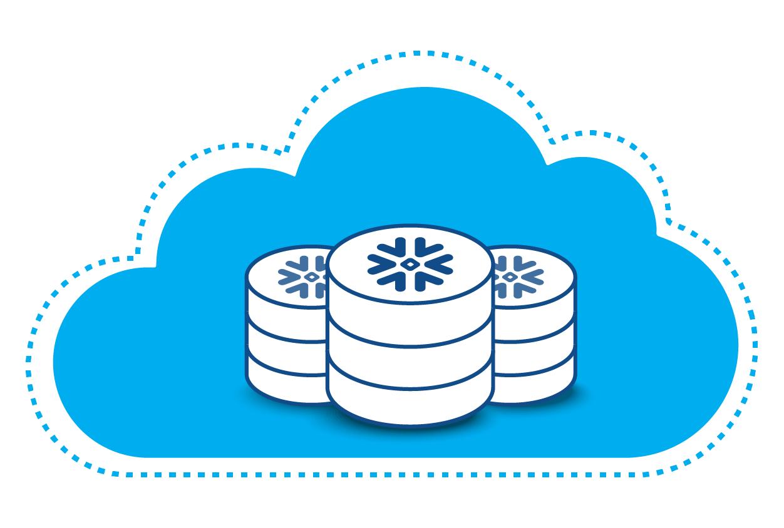



DataFlow Use Cases
Cached In-Memory
Embrace
BI Layer
BI Layer
Falcon
Data Load
Live-Queries
External database, CSVs, Apps, etc.
External data warehouse

Slide 19
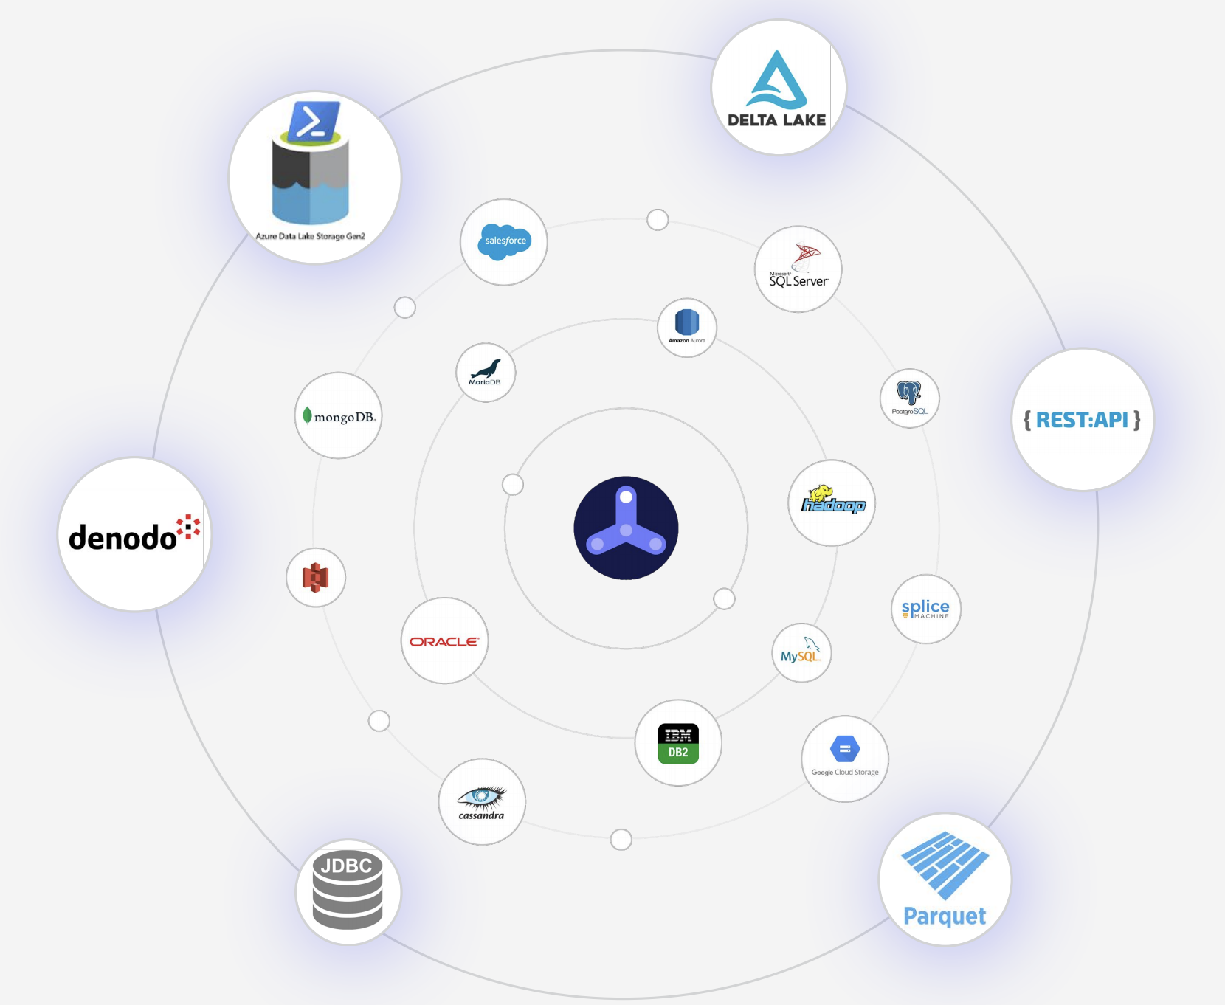
DataFlow Use Cases
Large historical repository in data warehouse, only a subset of which is needed for search and analytics
Preference for analyst-friendly, code-free experience
Data in disparate sources
Need for frequent data refresh

Slide 20








DataFlow Key Features
Native connectors
Data mapping
Point-and-Click
Sync scheduling
Granular selection
TQL Interface
Load incremental data
Alerts and monitoring

Slide 21
Overview of DataFlow process
Create a connection
Add table to sync
Set sync properties
Sync data

Slide 22
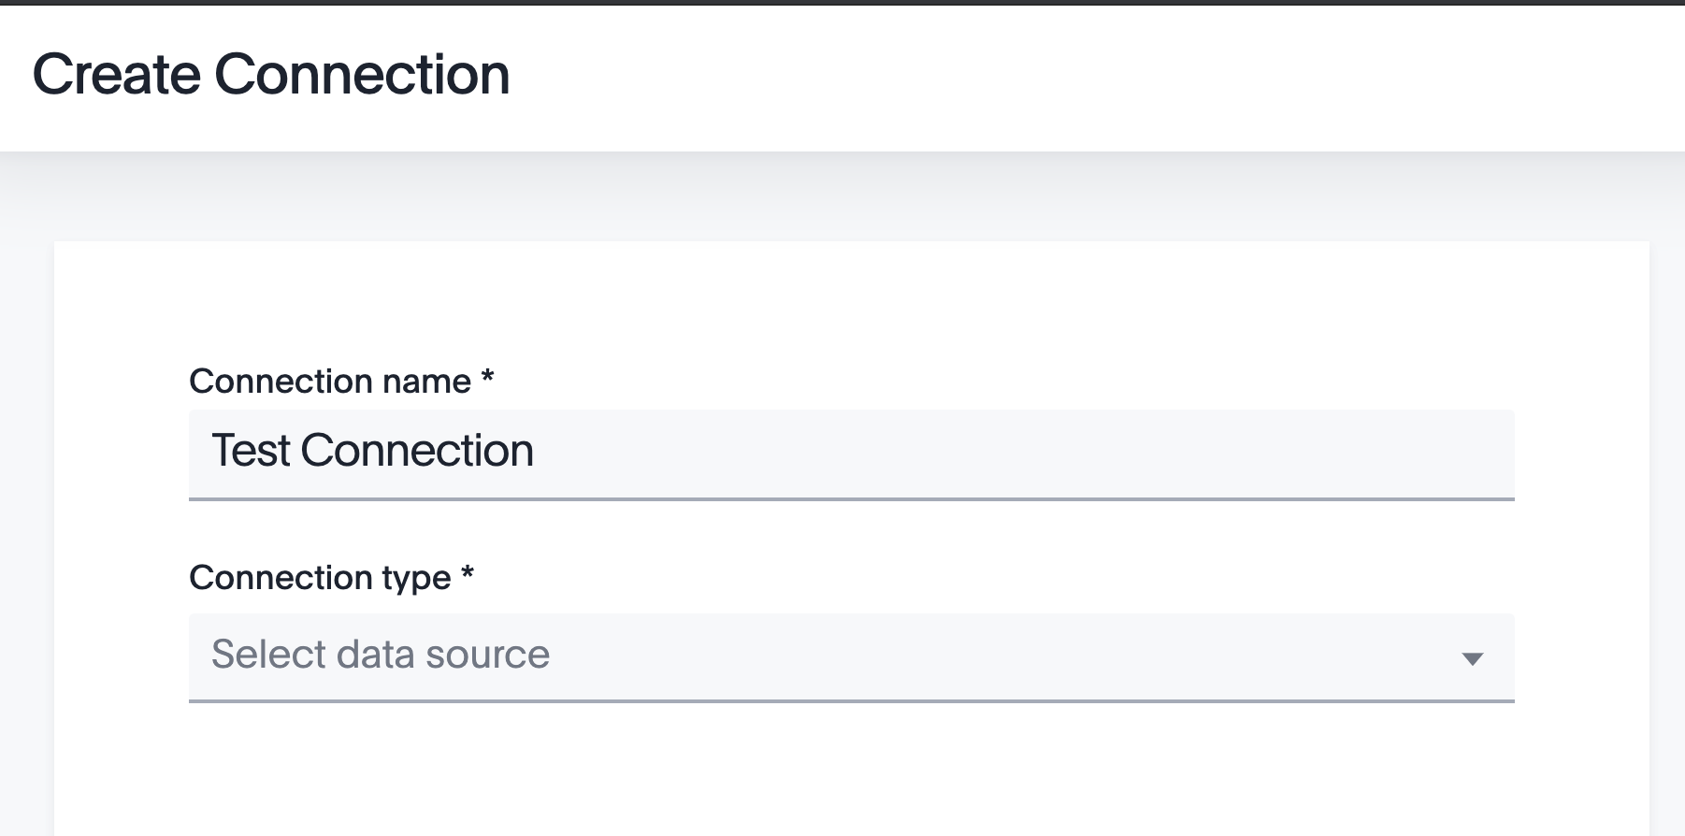
1. Create a connection
Create a connection
Add table to sync
Set sync properties
Sync data

Slide 23
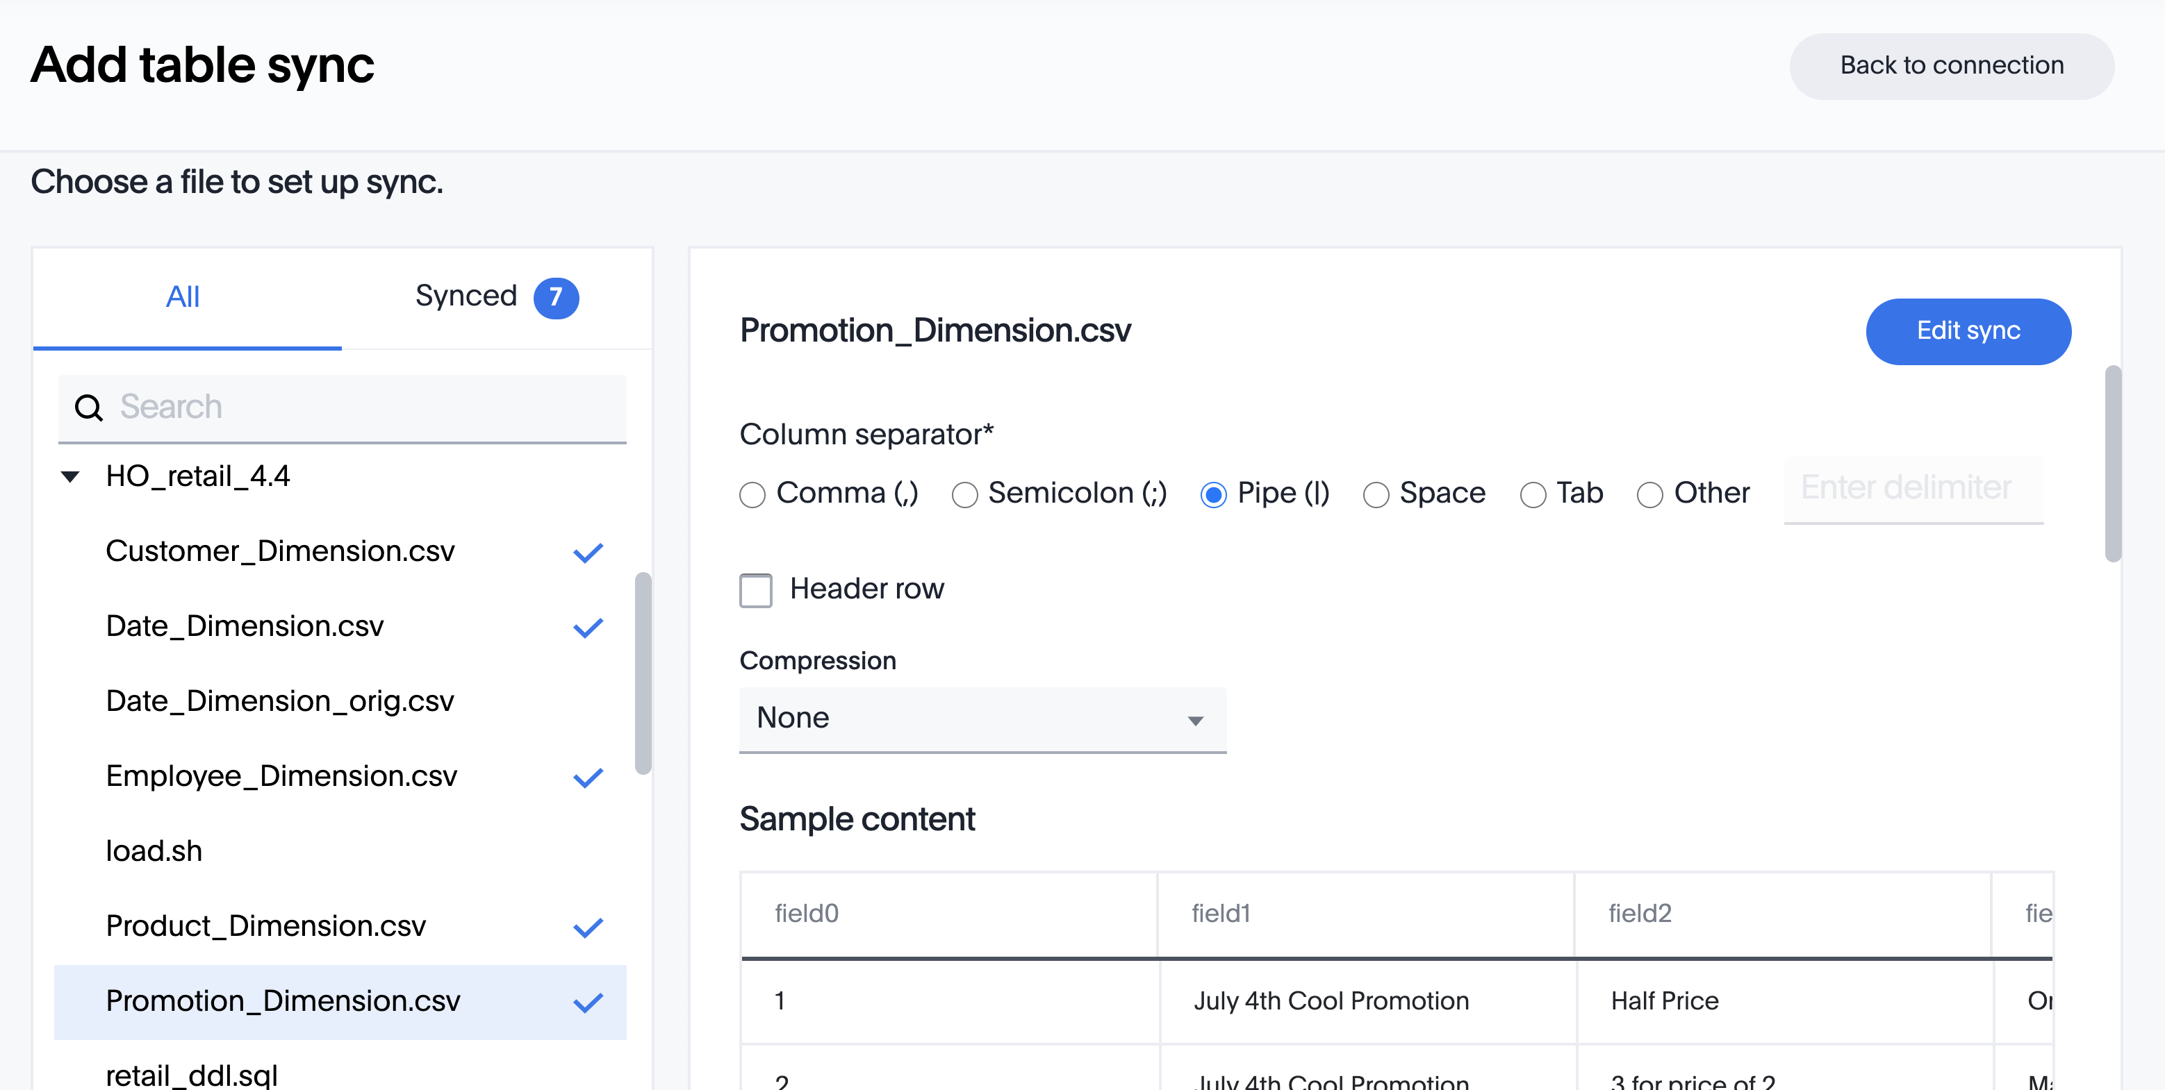
2. Add table
Create a connection
Add table to sync
Set sync properties
Sync data

Slide 24
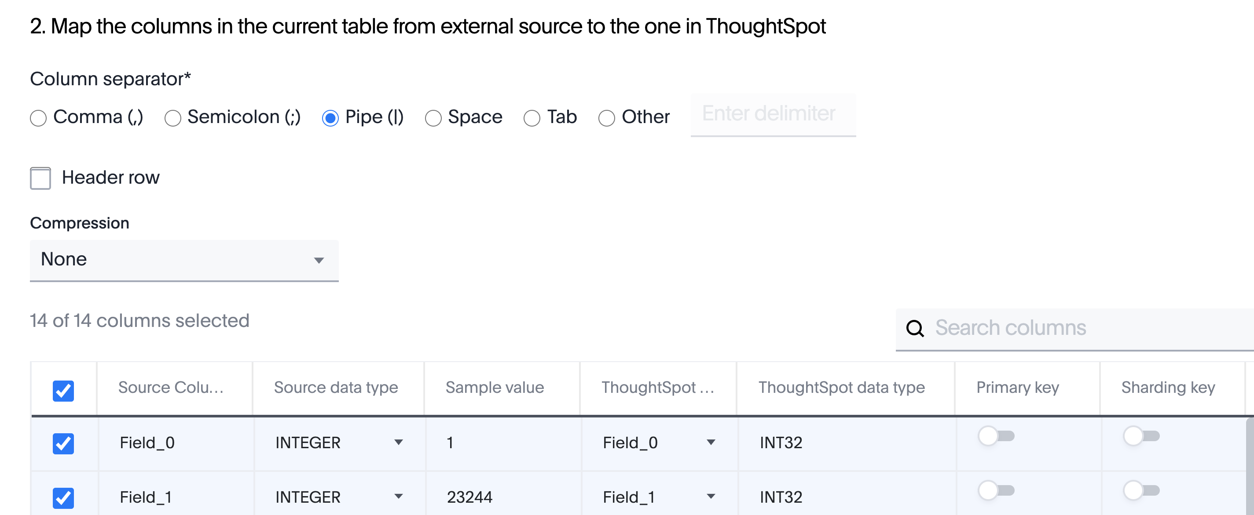
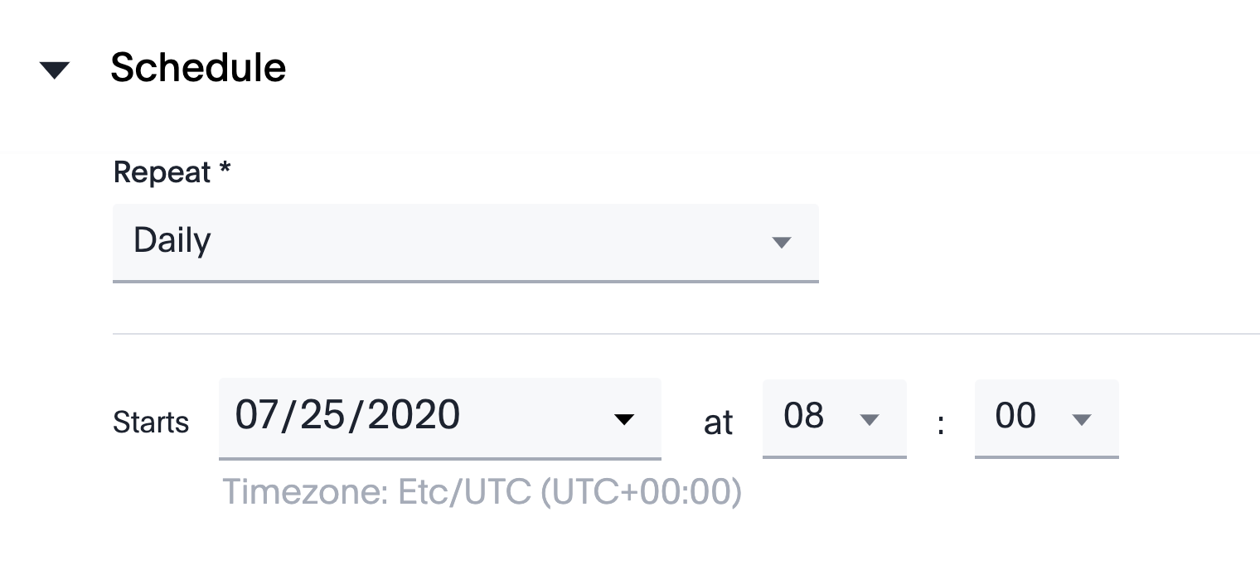
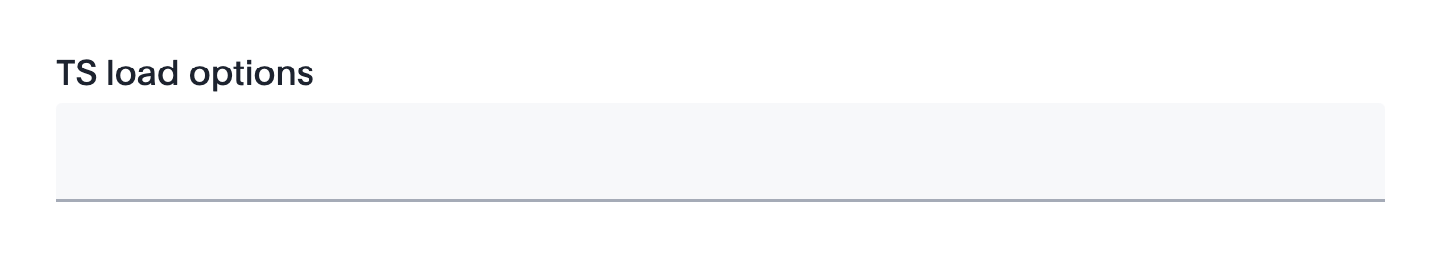
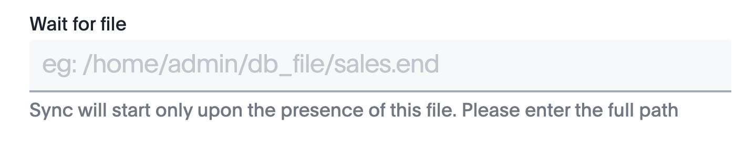
3. Set sync properties
Create a connection
Add table to sync
Set sync properties
Sync data

Slide 25

4. Sync data
Create a connection
Add table to sync
Set sync properties
Sync data

Slide 26
Overview of DataFlow process
Create a connection
Add table to sync
Set sync properties
Sync data

Slide 27
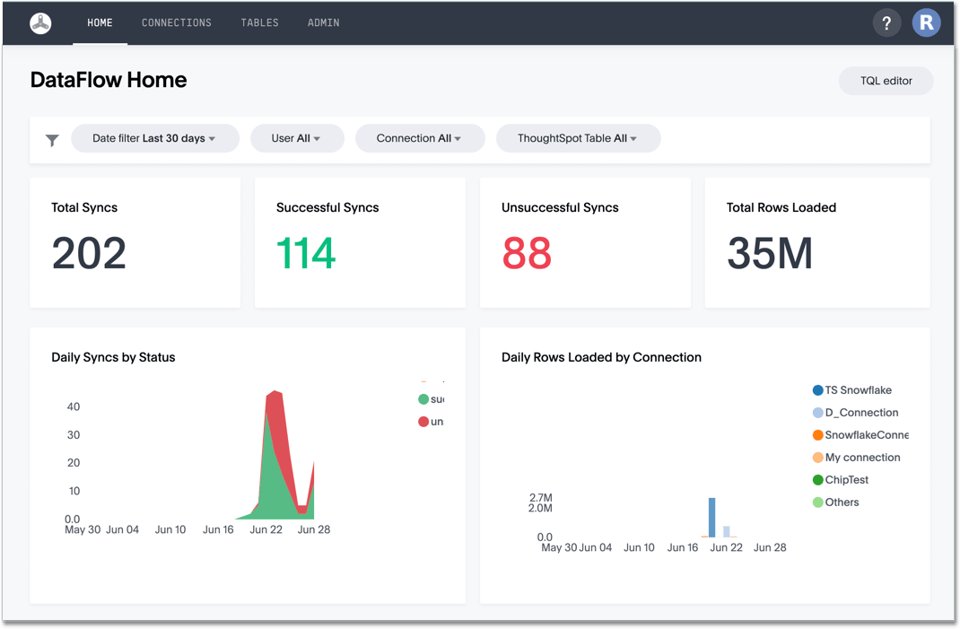
DataFlow Home
The DataFlow Home interface reports all historical syncing information
Use filters to view the Home dashboard for a desired timeframe, user, connection, or table.
Notes:
With a single glance, the Home interface for Dataflow reports the sync performance across your entire organization.

Slide 28
Add a DataFlow connection

Slide 29
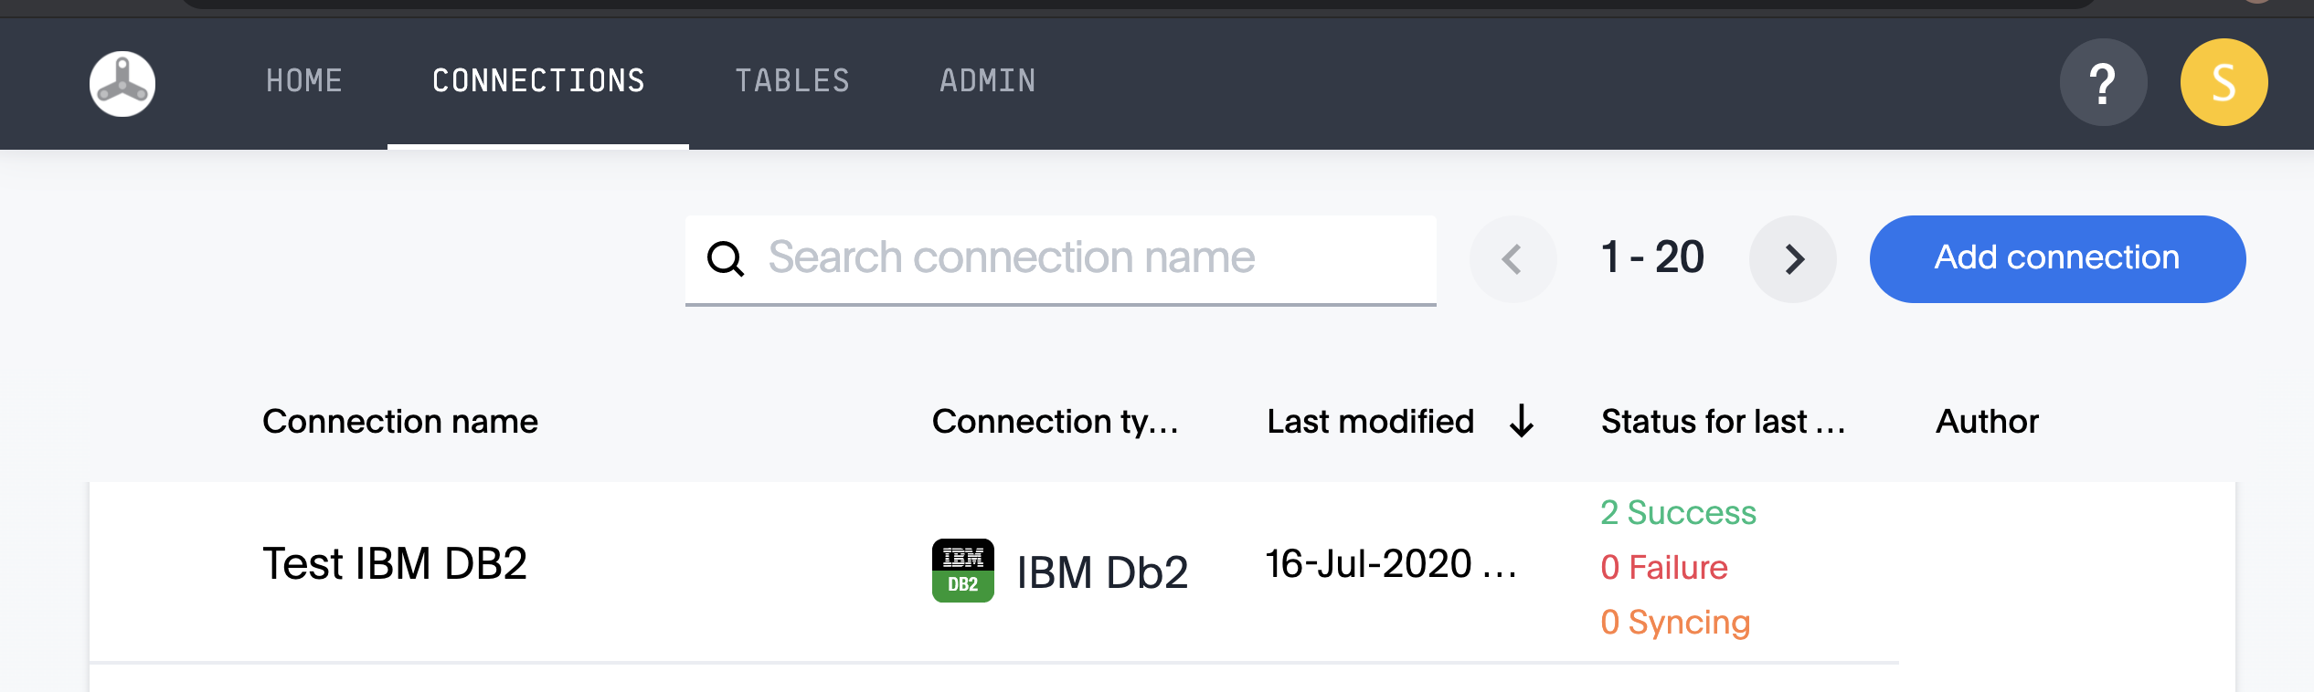
Add a Connection
Create a new DataFlow connection in the Connections page, from the top bar. Click Add connection in the top right corner.

Slide 30
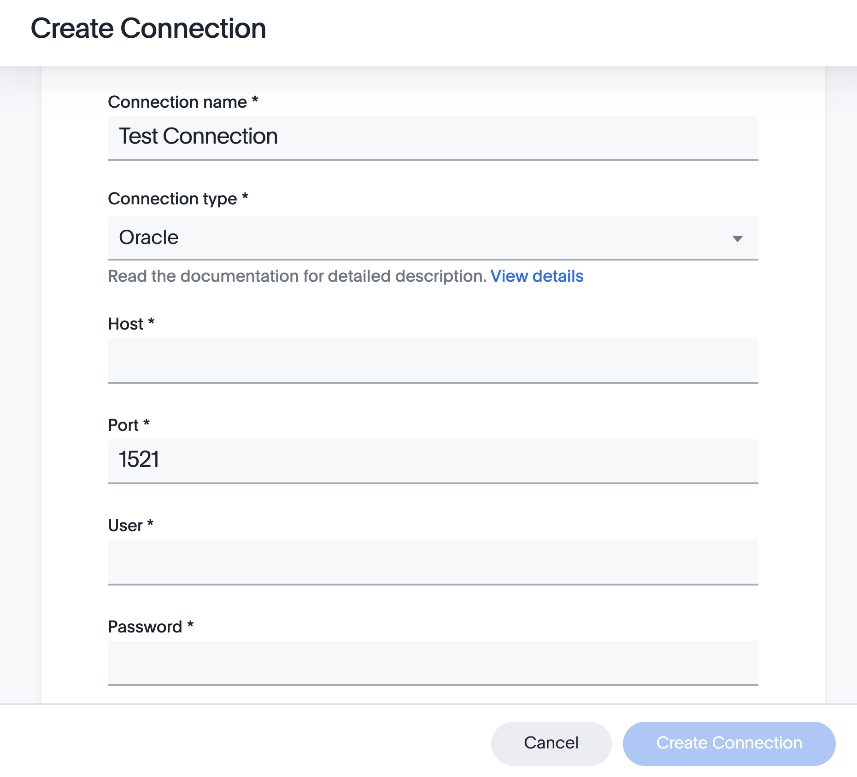

Create a Connection
Enter a name for your connection, and select your data source from the Connection Type list.
Based on your connection type, additional fields will appear. Complete these connection properties, then click Create Connection.

Slide 31
Sync data through a connection

Slide 32
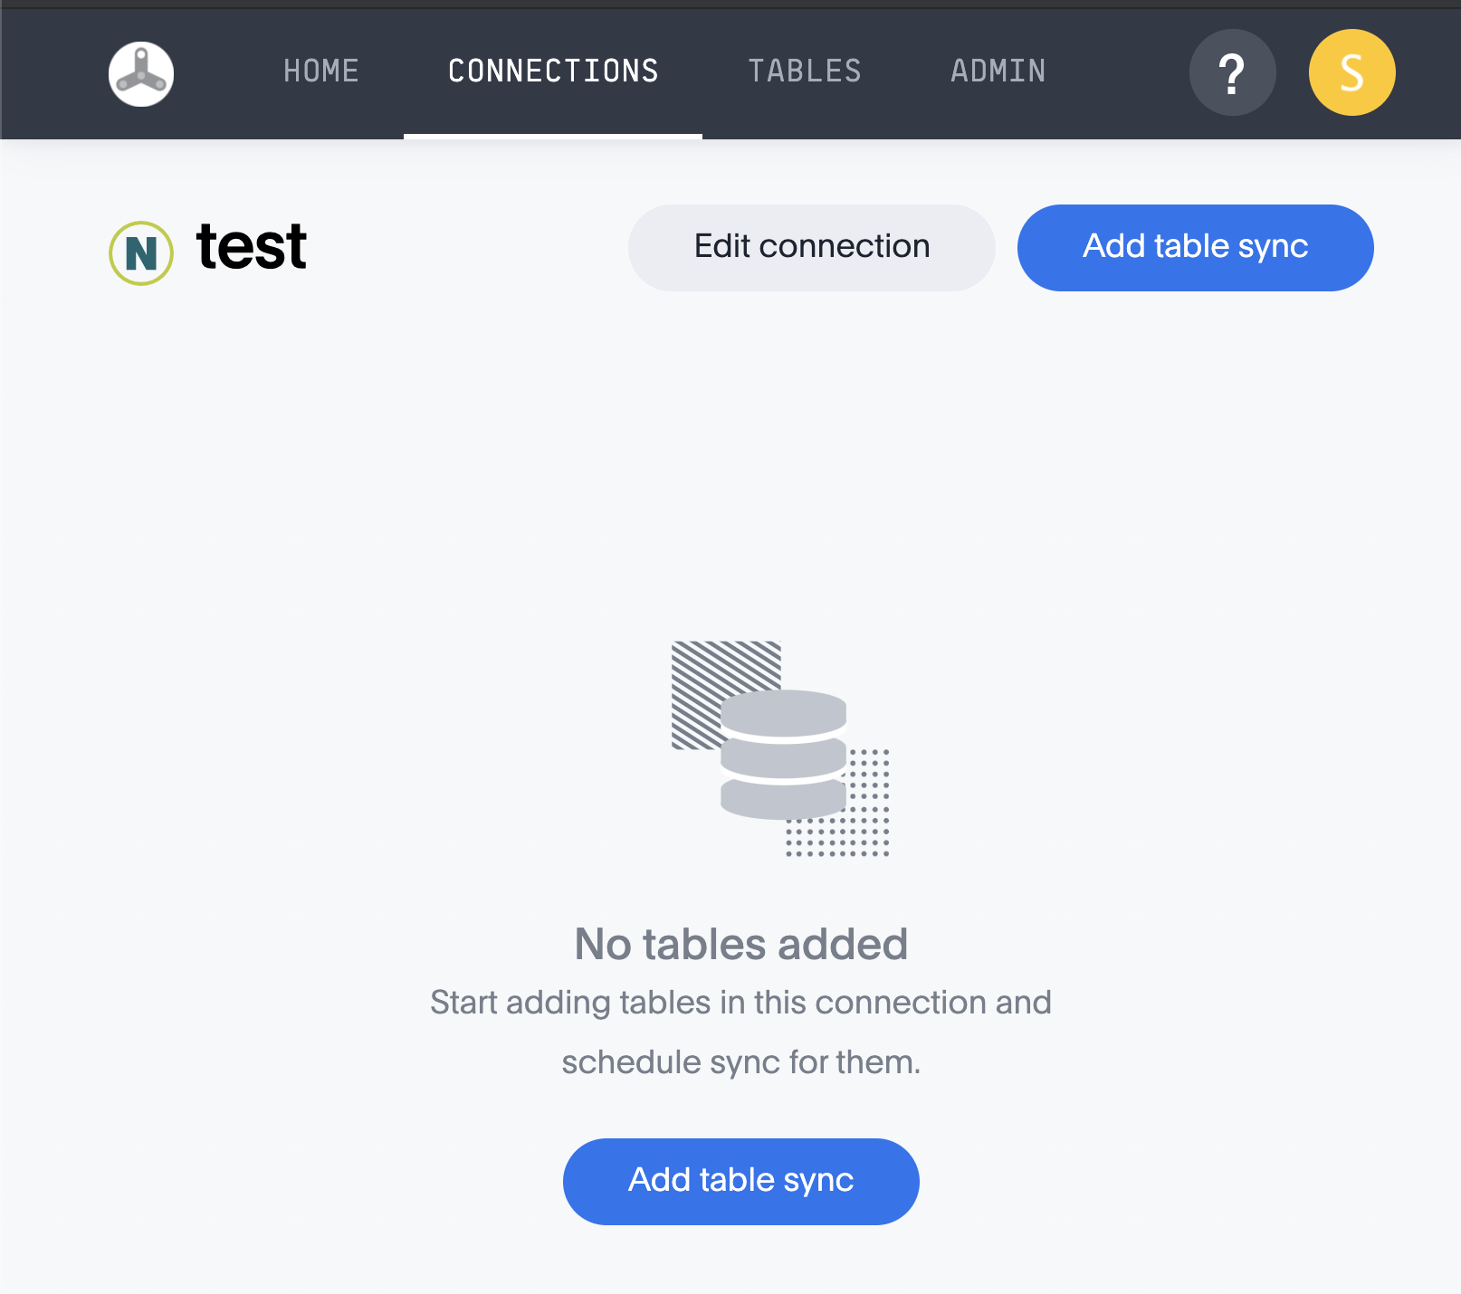
Add tables to sync
A connection has been created, and now the tables to sync must be added.
Click Add table sync to set up table syncing.

Slide 33
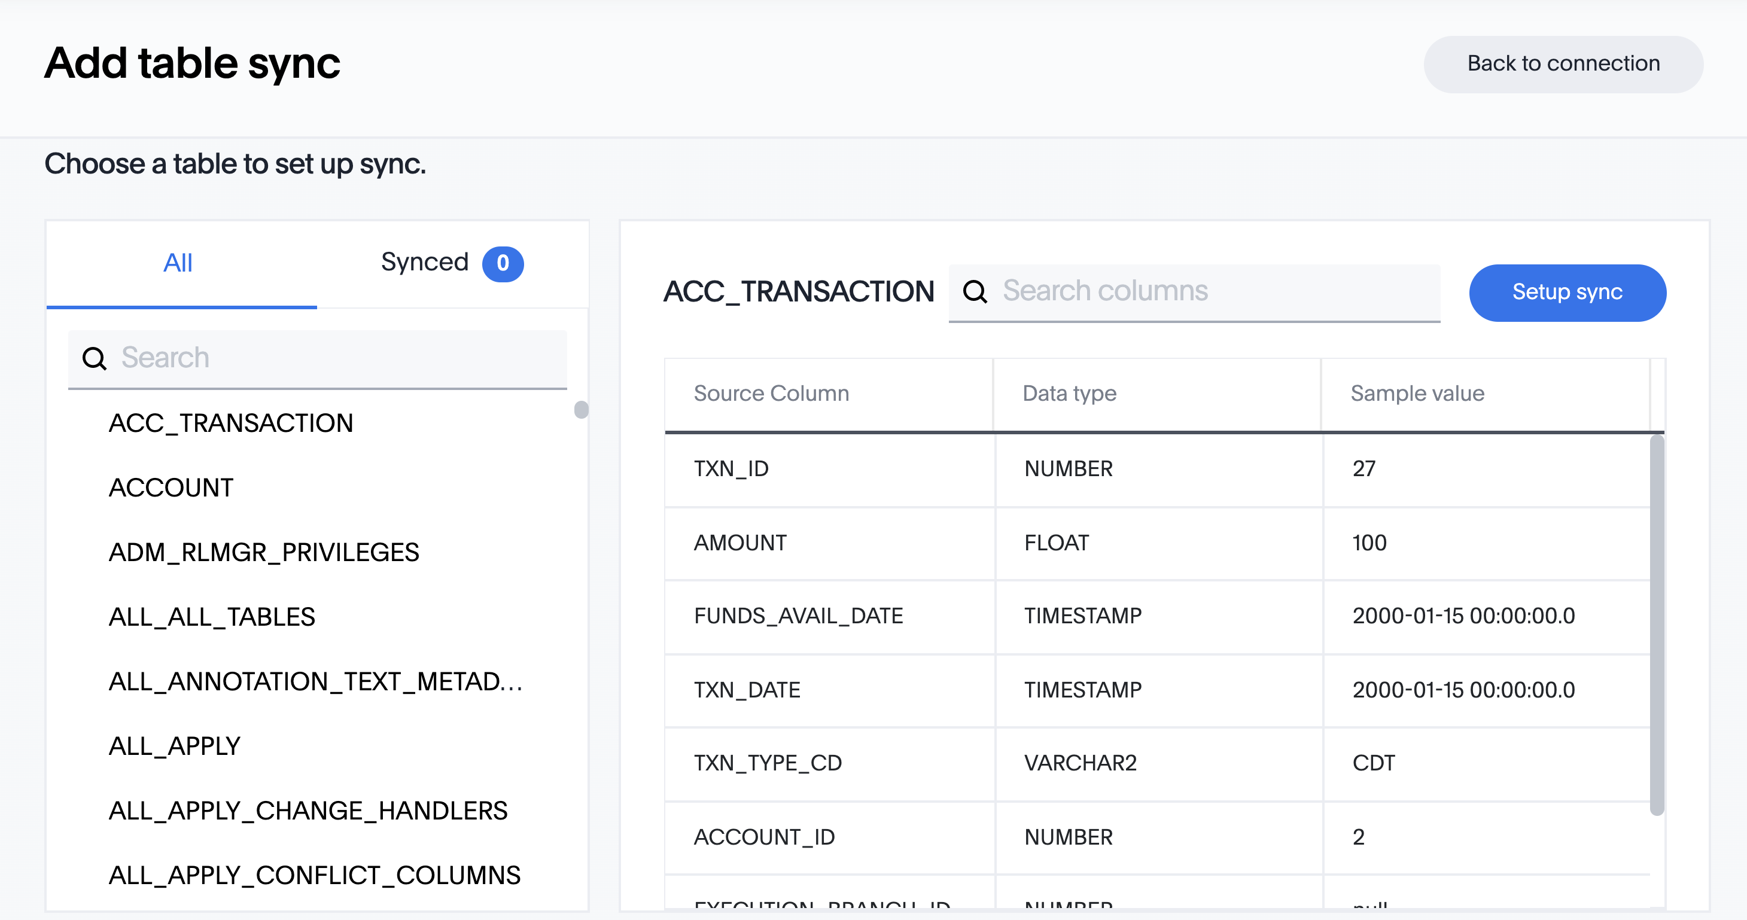
Add tables to sync (cont.)
On the database selector, scroll to select and open the source database. Then, select the table you plan to sync. Click Setup sync.
Notes:
Before confirming that you plan to sync a particular table, examine it to ensure that it has the right information: the correct data types, and reasonable sample data.
For large tables, use the search bar to search column names.

Slide 34
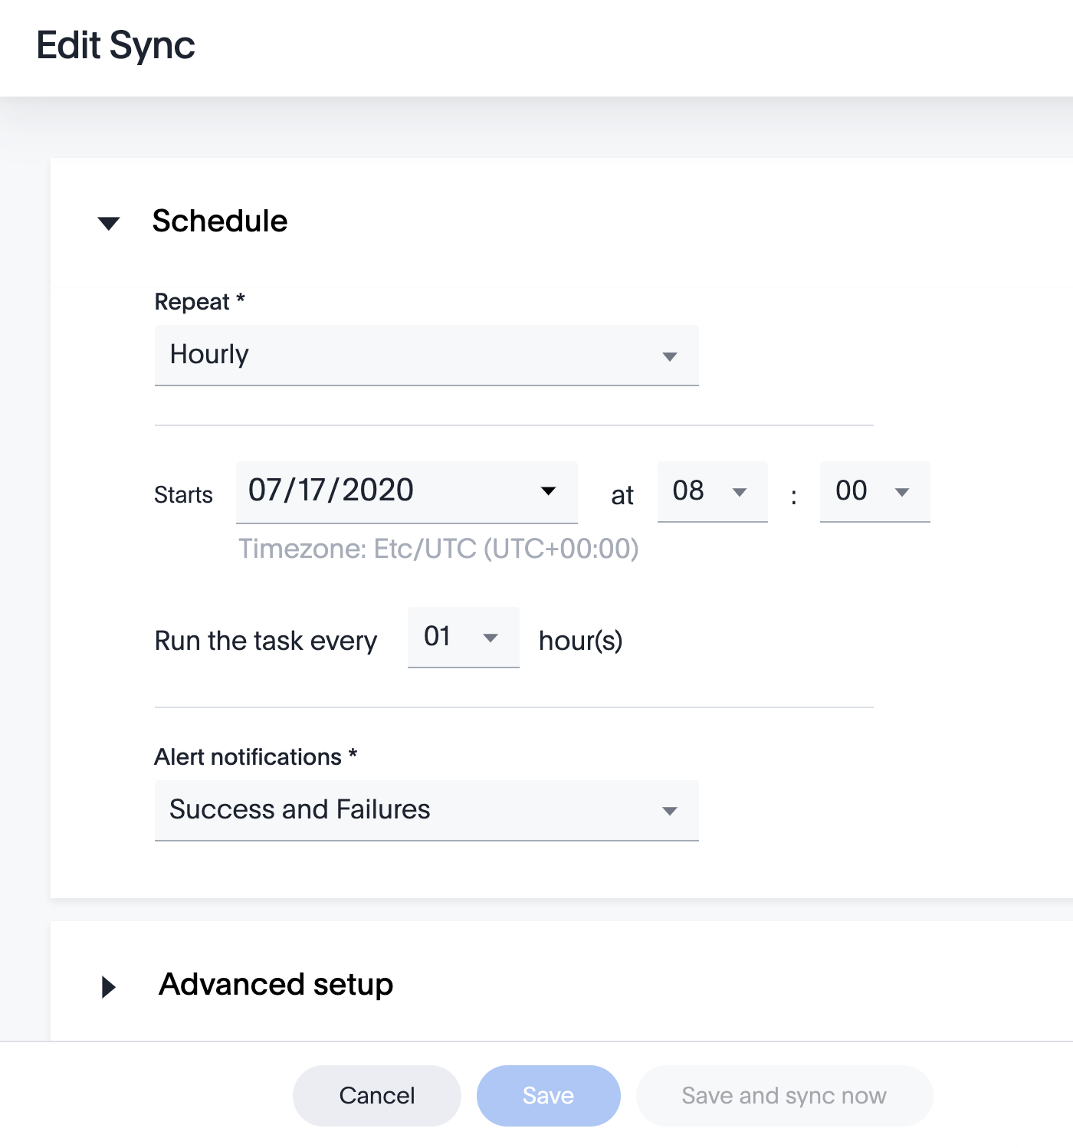

Specify Sync Schedule
Specify the sync schedule by selecting from the list of scheduling options in the Repeat field.
For one time loads, select the Does Not Repeat option.
Click Save, or Save and sync now to either save the schedule, or save the schedule and start the sync immediately.

Slide 35
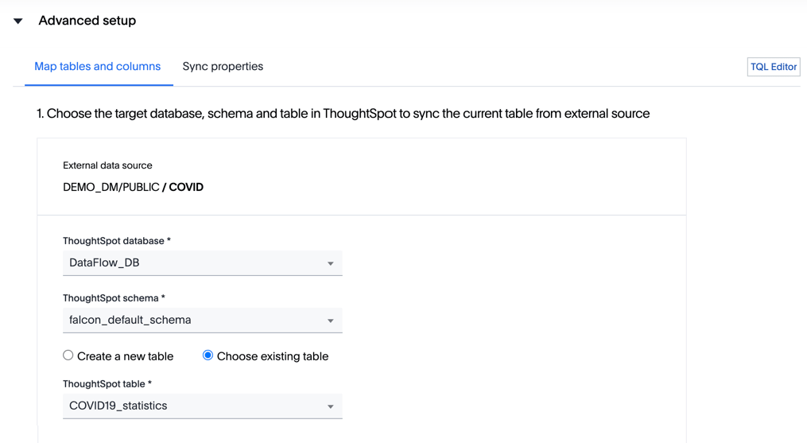
Map tables
To map the external tables to ThoughtSpot’s database, open the Advanced setup interface, which is located just under the Schedule interface.
Select an existing ThoughtSpot database.
or
Use TQL Editor to create a new database.
Notes:
If you wish to create a new database in ThoughtSpot, click TQL Editor, enter the CREATE DATABASE my_database; command, and click Execute.

Slide 36
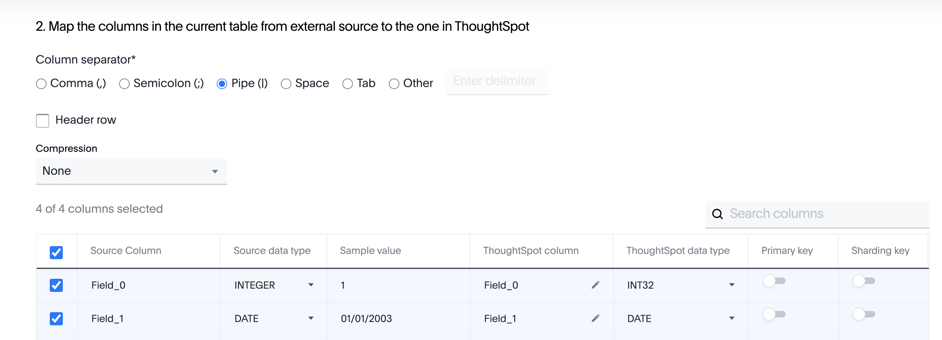
Map tables (cont.)
Then, select which columns in the table from the external source to sync to the ThoughtSpot table. You can change the name of the column as it will appear in ThoughtSpot by editing the Thoughtspot column field.
Notes:
Select the correct column separator, and indicate whether the table in the external source has column headers in the first row.

Slide 37
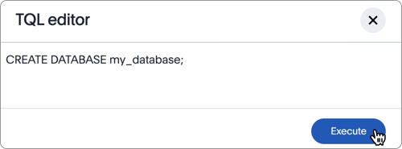
Create a new database with TQL Editor
If a database does not yet exist for the table you are syncing, you may create one in the TQL Editor.
Click the TQL Editor, enter the command CREATE DATABASE databasename; and click Execute.

Slide 38
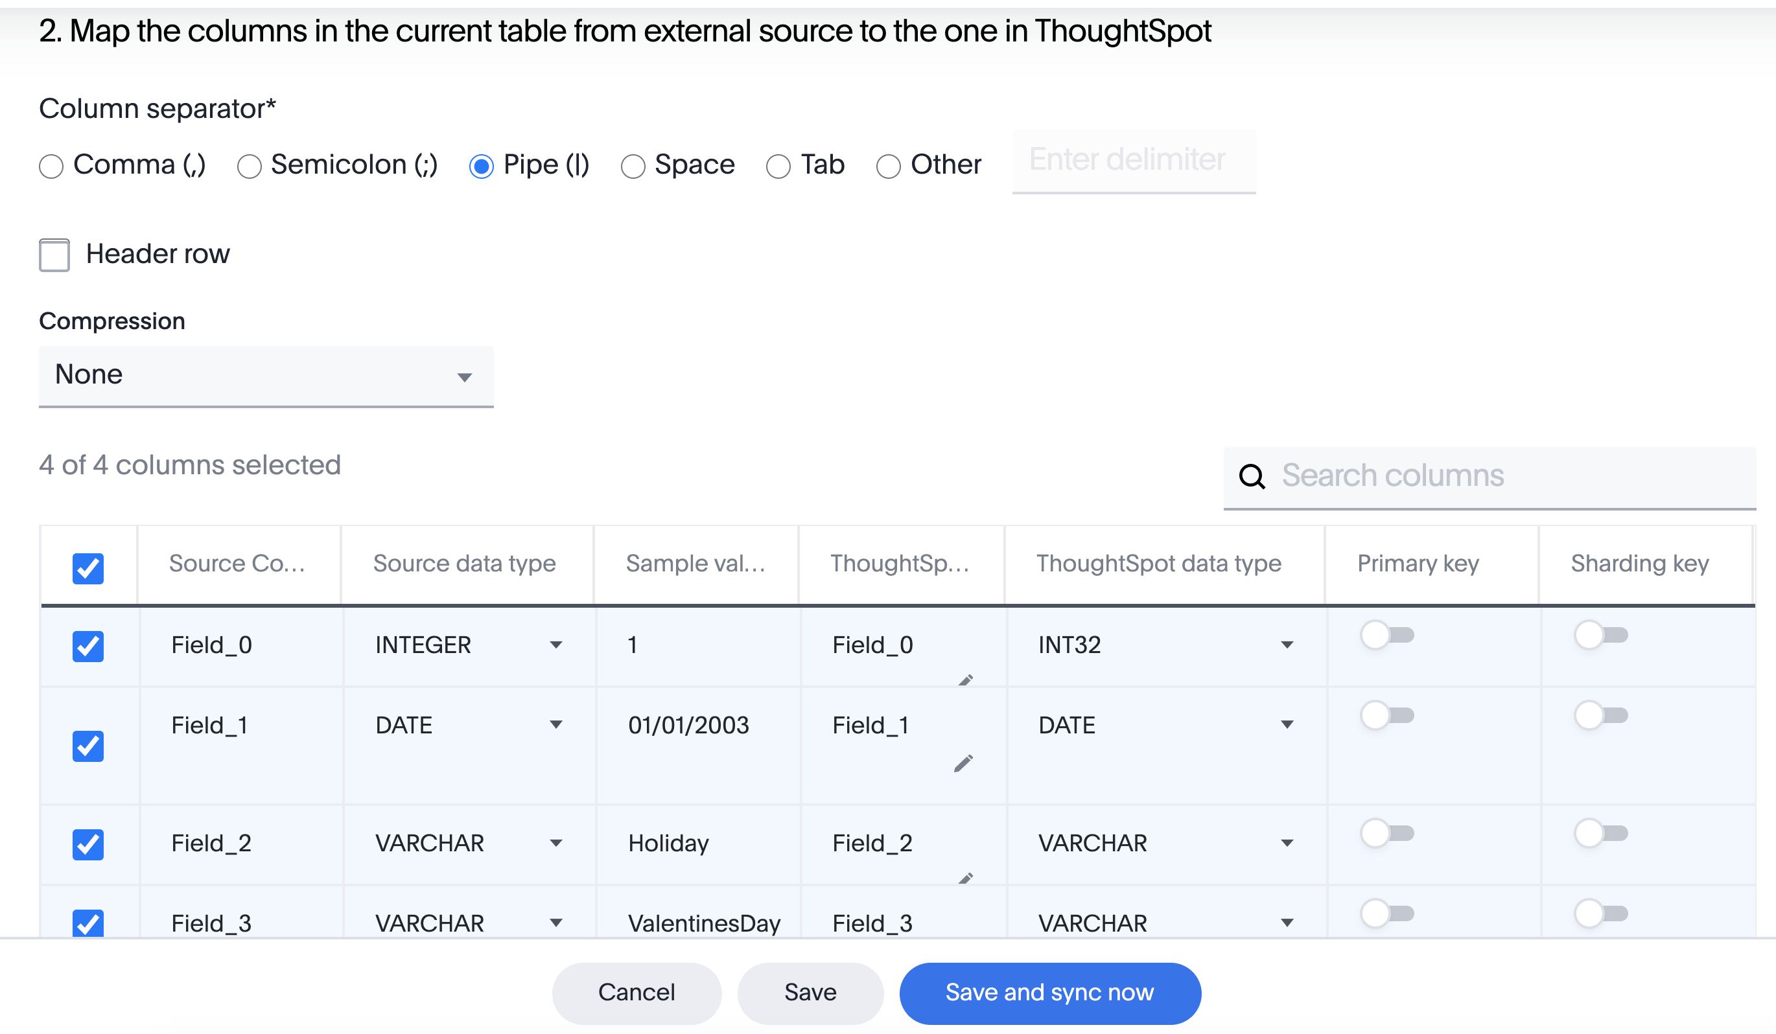
Identify Primary and Sharding Key
If a Primary Key is identified in the external source, it will be carried over into ThoughtSpot. If not, you can identify the primary key(s) when mapping the columns.
Note that sharding key column(s) must be primary key column(s).
Then, click Save and sync now.

Slide 39
Example: Create connection and sync data with Salesforce

Slide 40
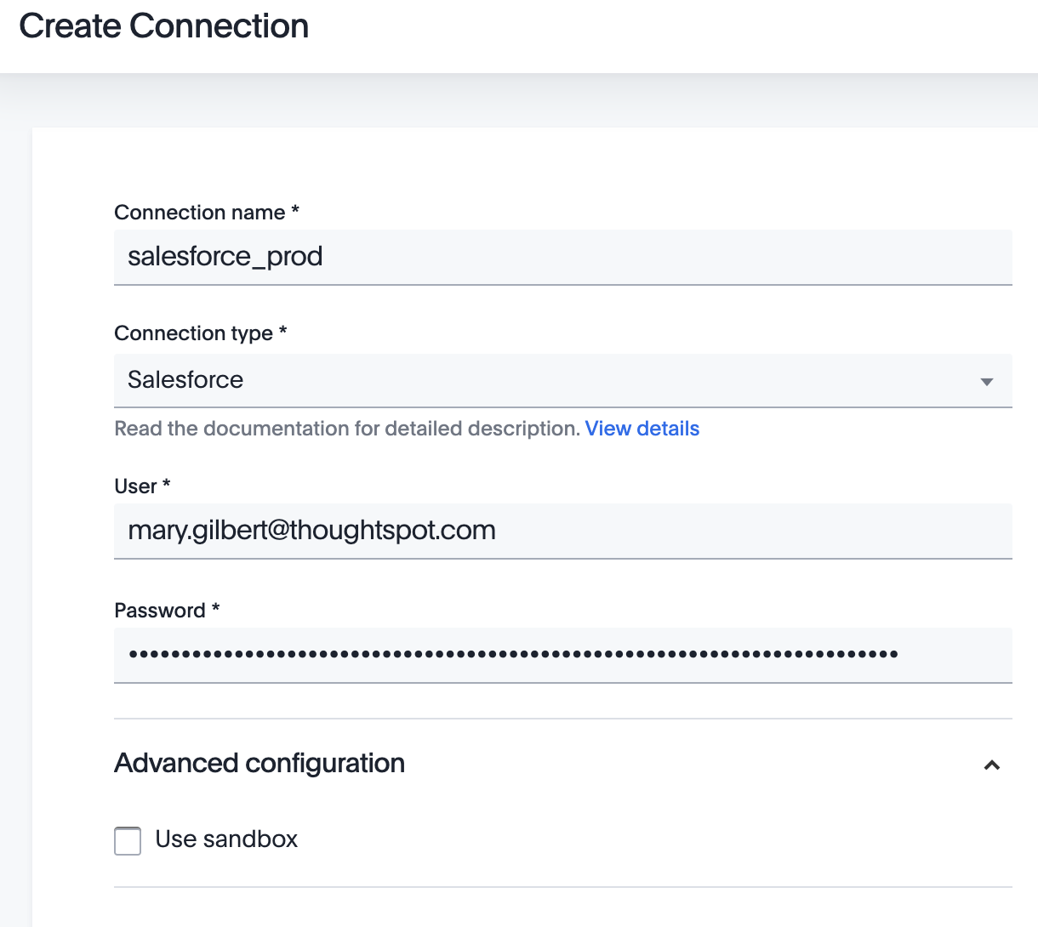
Create a Salesforce Connection
Enter a name for your connection, and select Salesforce as your Connection Type.
Enter your Salesforce account credentials in the fields that appear, then click Create Connection.

Slide 41
Add Salesforce tables to sync
A connection to Salesforce has been created, and now the tables to sync must be added.
Click Add table sync to set up table syncing.

Slide 42
Add Salesforce tables to sync (cont.)
On the database selector, scroll to select and open the source database. Then, select the table you plan to sync. Click Setup sync.
Notes:
Before confirming that you plan to sync a particular table, examine it to ensure that it has the right information: the correct data types, and reasonable sample data.
For large tables, use the search bar to search column names.

Slide 43
Set Sync Properties

Slide 44
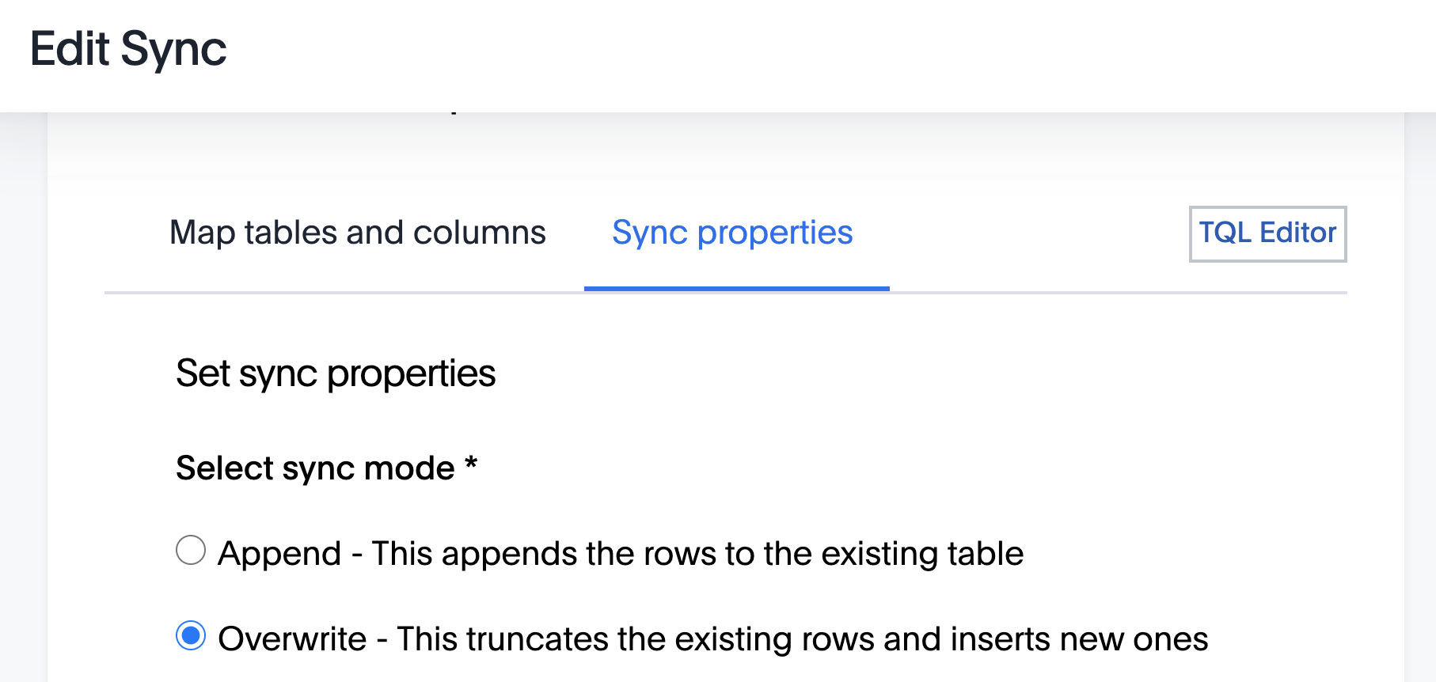
Sync Properties
To set the sync properties, open the Advanced setup interface. Indicate whether the table should be appended or overwritten upon syncing.

Slide 45
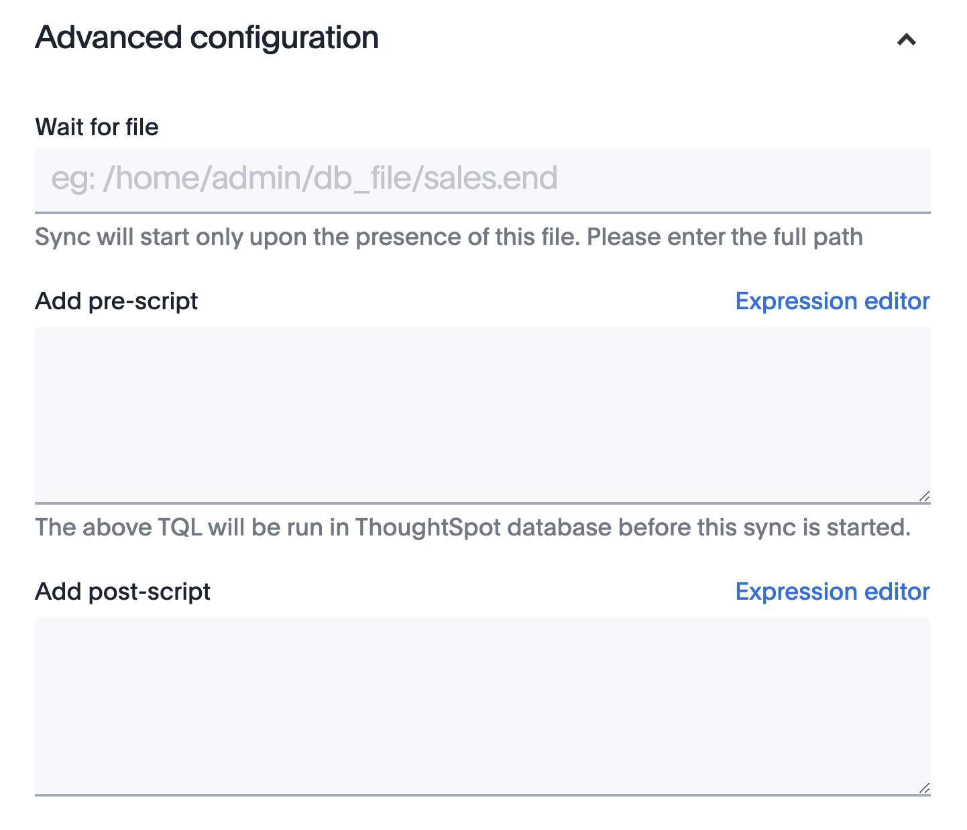
Sync Properties (cont.)
You can also add sync scripts here, in the Advanced configuration interface.
You may add a SQL script to run either before, or after, syncing. These are optional.
Notes:
Use cases here?

Slide 46
Manage DataFlow users

Slide 47
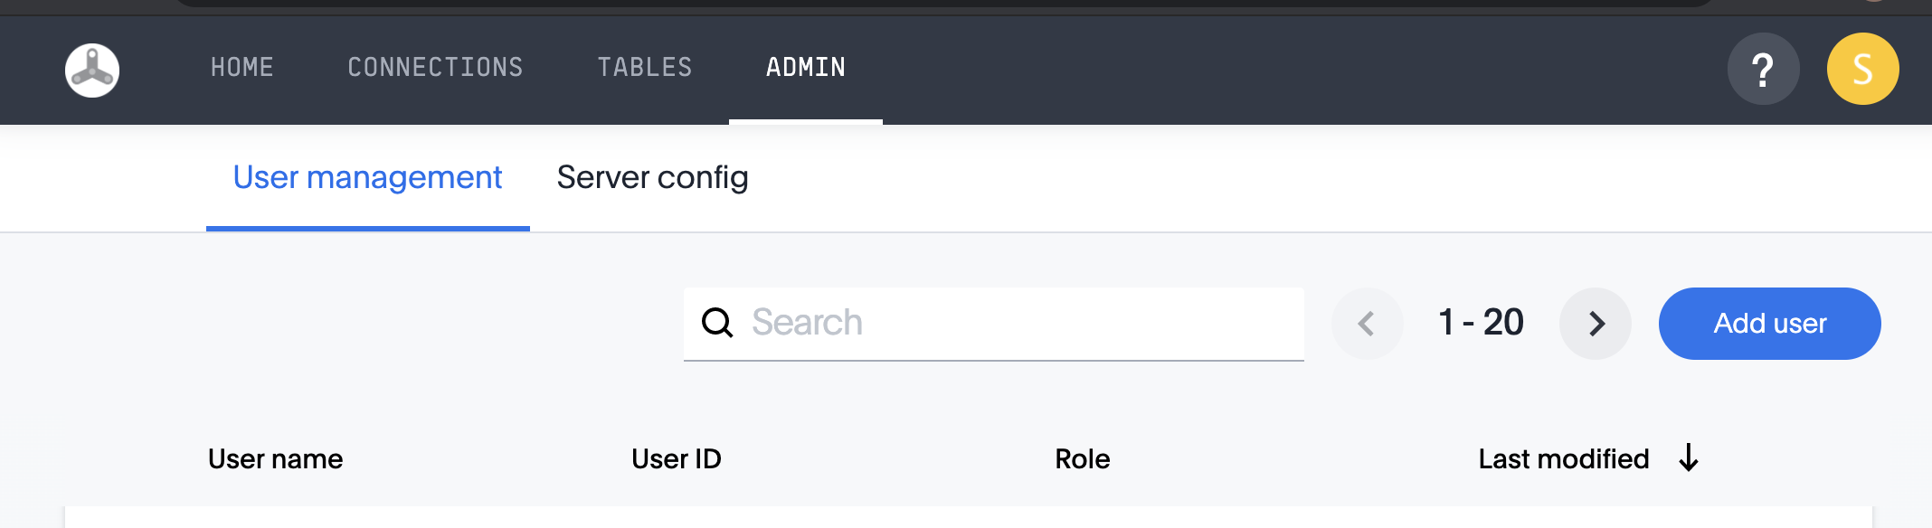
Manage DataFlow users
Administrators can add and manage DataFlow users. From the Admin page, click Add user.

Slide 48
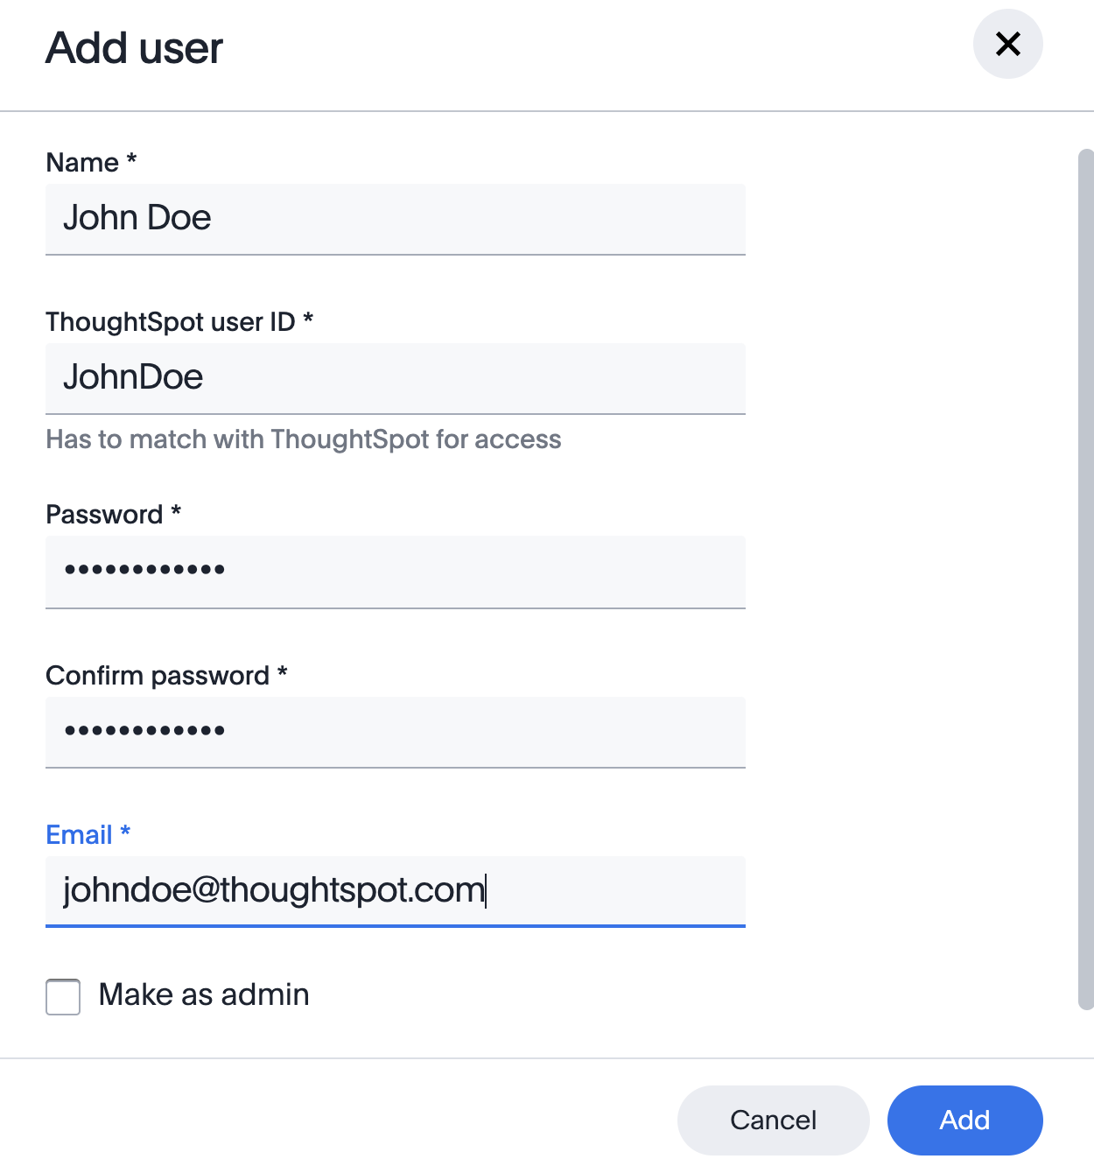
Add DataFlow users
Enter the information for the new DataFlow user in the fields shown.
The user ID must match an existing ThoughtSpot account, while the password does not have to match the user’s ThoughtSpot password.

Slide 49
Make changes to an existing DataFlow user
Make changes to an existing user account by clicking on their username in the User Management tab of the Admin page.

Slide 50
Loading Data with tsload
Version 6.3
© ThoughtSpot Inc 2019

Slide 51
Prerequisites
A laptop or PC with Internet access
Browser (Chrome preferred)
Terminal emulator:
MacOS: iTerm or Terminal Windows: Putty or similar
Basic understanding of databases and SQL
DDL (data definition language), primary key/foreign key, joins
Basic Linux (scp, ssh, ls, cd, cat, unzip)
Notes:
Review what is needed for mac vs. PC
You won’t need to actually need to use SCP because we have pre-staged the files for you, but we still want you to know about it
I’m going to be on a mac
It’s helpful but not required if you’re familiar with databases and SQL, specifically DDL Data Definition Language (the other type of SQL we talk about is DML which is mostly used for querying, but we won’t be using DML because in TS we use the search bar- and we won’t be creating complex nested queries or anything like that, that’s all handled in the search bar)
But we do need DDL which is things like CREATE TABLE, definition of tables, adding foreign key, this we will be doing
Basic linux (so basic that we list the commands) because these are the only ones we need: Scp (secure copy) ssh (secure shell) ls (list contents of directionry) cd (changes directory) cat (look at file within terminal unzip (unzip)- very basic
When we go through them, if you get stuck, I’ll try to go fairly slow but if you find that you’re stuck raise your hand and we’ll help you so we can help you.
IP Address Slides

Slide 52
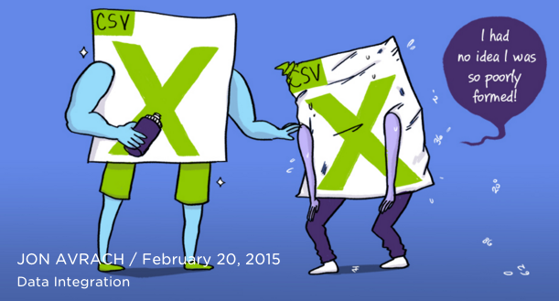
Working with CSV files
Datasets always need some tweaks.

Slide 53
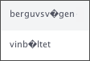
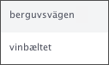
Working with CSV files
Convert carriage returns from Windows to Linux:
tr '\r\n' '\n' < orig_filename > new_file
Files should be UTF-8 encoded.
Use the “file” command to see what the encoding it is.
Use “iconv” if you need to convert to UTF-8
$ iconv -f -t UTF-8 in_file.csv > out_file.csv
Notes:
Another command you will try to fix carriage returns.
The files coming into TS should be UTF 8 encoded. If it’s not and there’s any characters in there that’s multibyte (e.g. n with curly on top or an umlaut), the file is not UTF encoded, TS will accept it but you’ll see funny characters when you look at it within the browser. Example: little characters with ? I it, run iconv of uconf

Slide 54
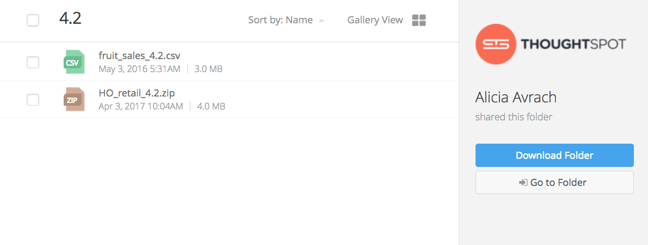

Download the Sample Data
Get the bundle of files from our secure file server: https://thoughtspot.egnyte.com/fl/AXHJCskFpq
Click link for HO_retail_4.4.zip to download the zip file.

Slide 55
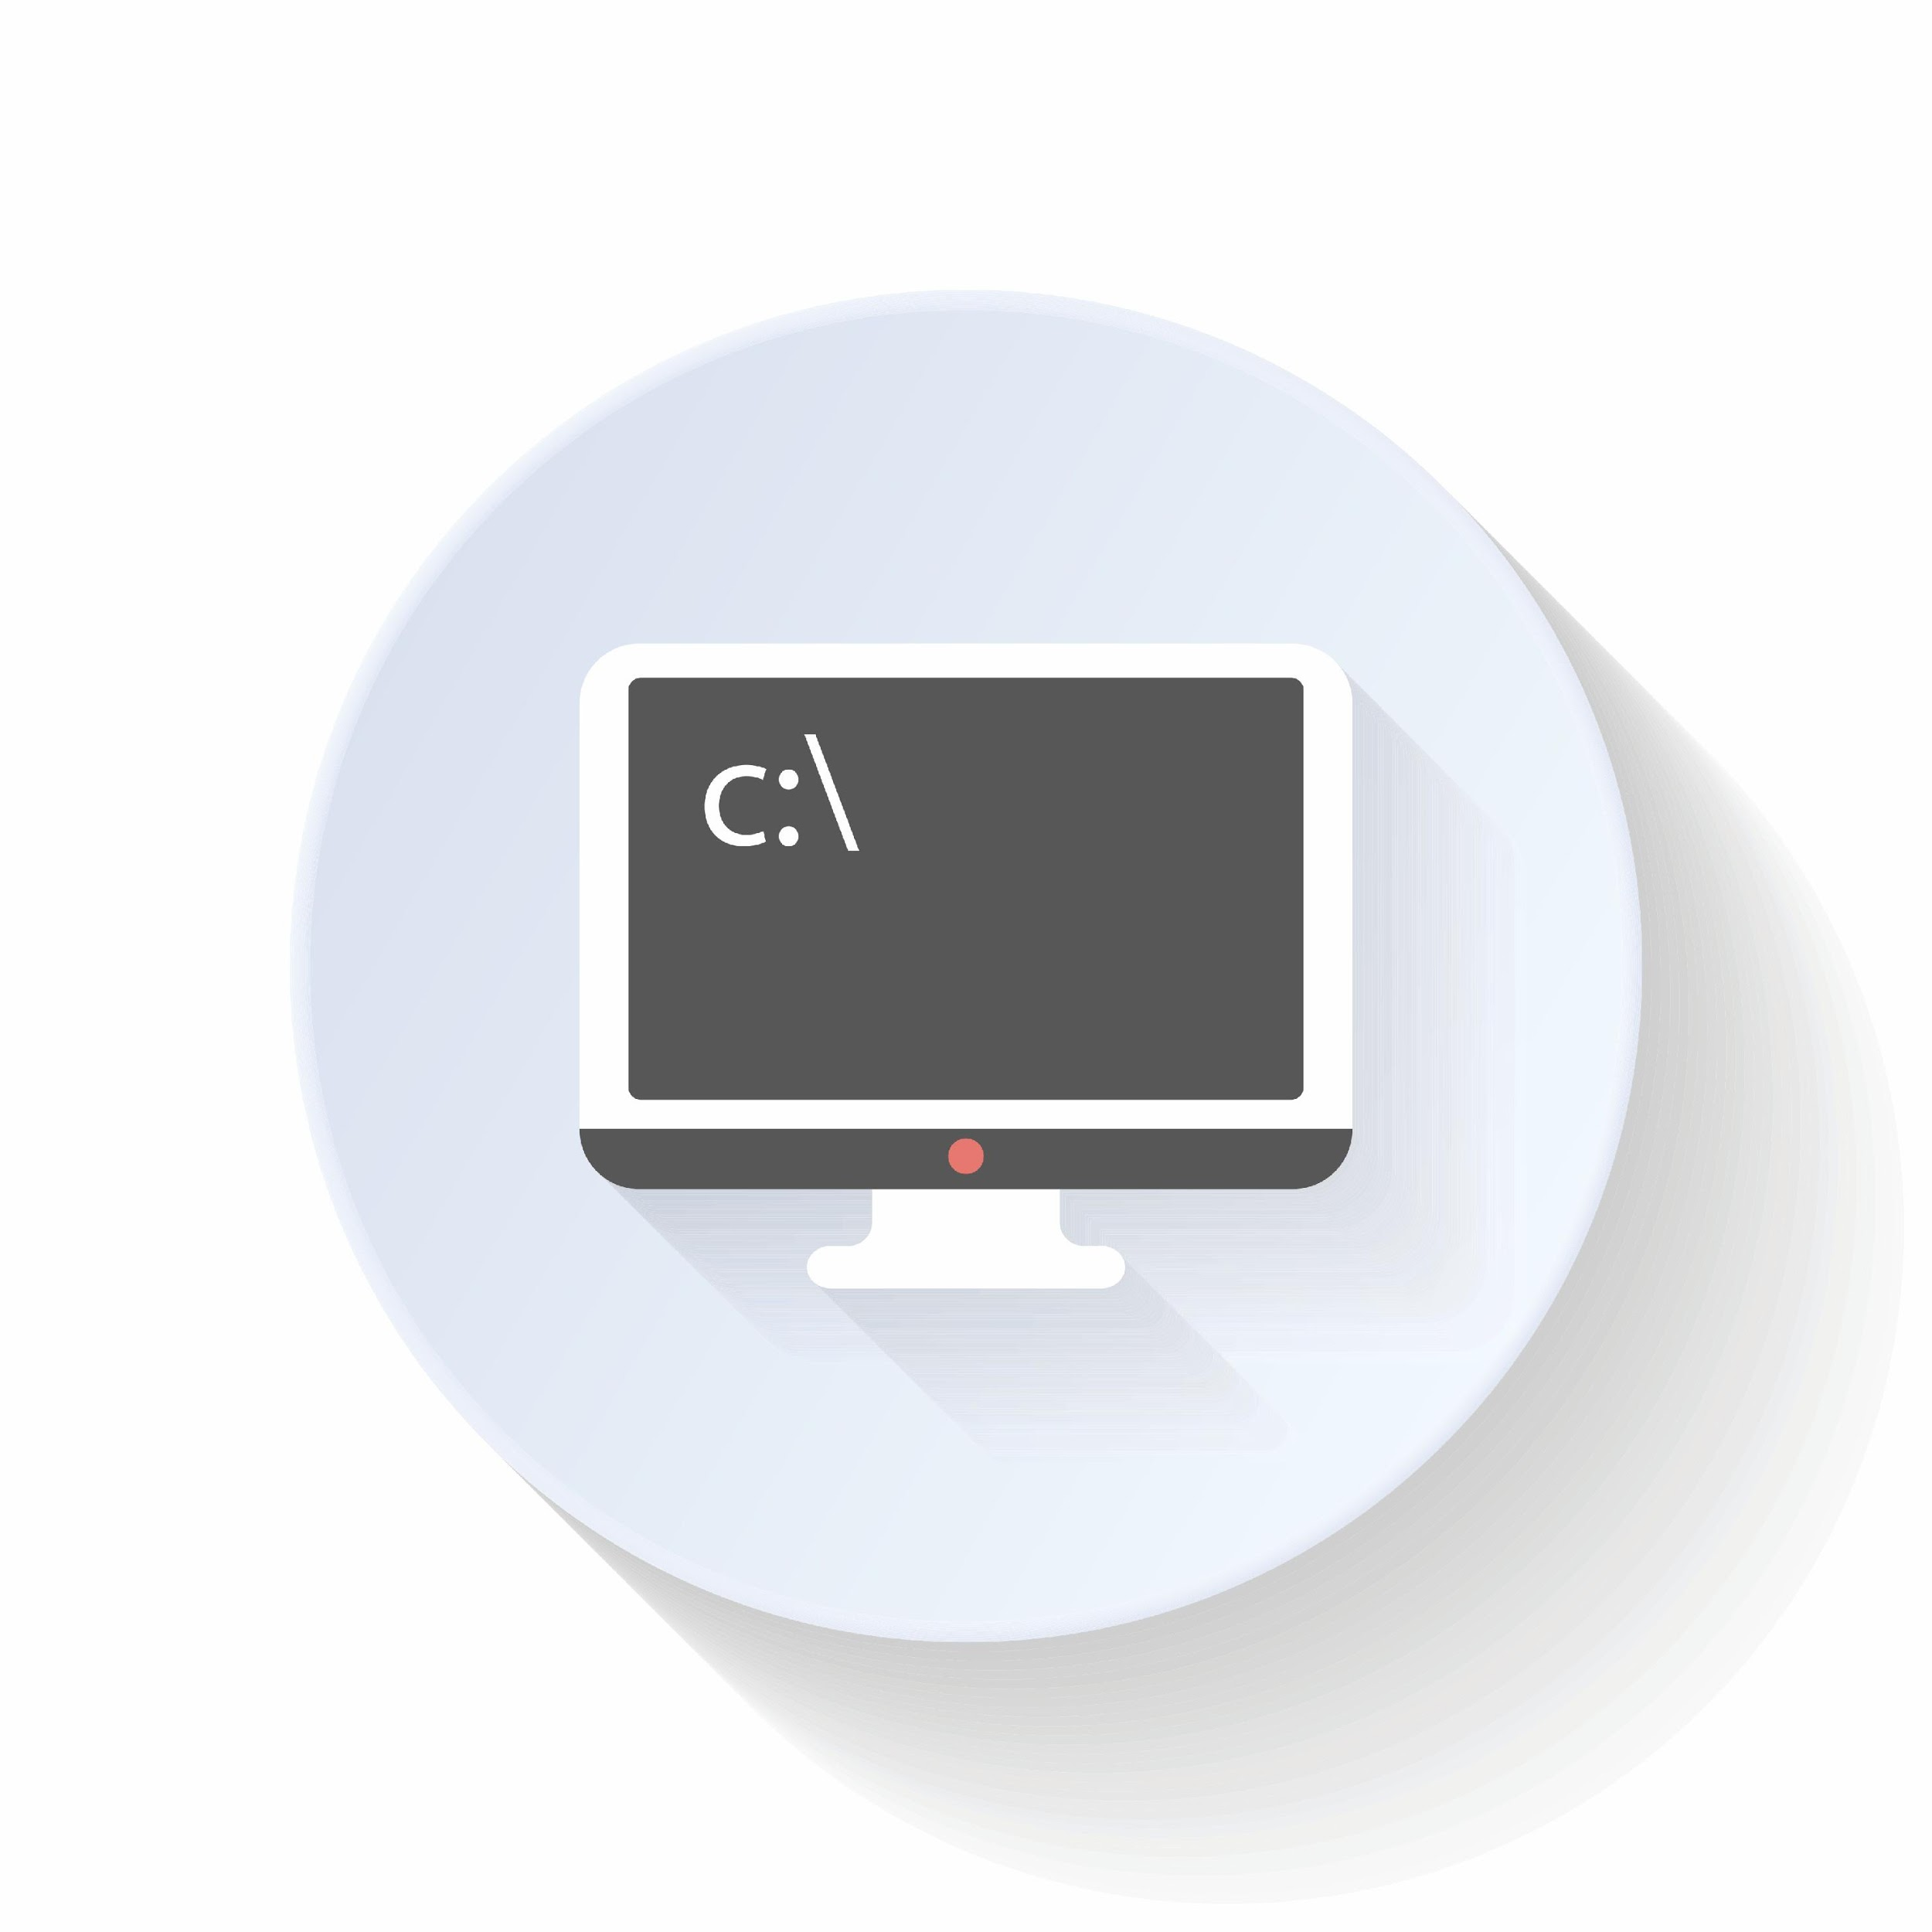
Steps for Data Loading
Download data from secure site (Egnyte)
Copy data files from local computer to cluster
Unzip files
(If data is pre-staged for training or demo purposes, drop databases)
Run SQL DDL Script in TQL
Load data into tables

Slide 56
Plan the Schema

Slide 57


What is TQL?
A command line, interactive SQL shell for ThoughtSpot
TQL can be used for:
Creating databases, schemas, and tables
Sanity checking data loads
Changing a schema (primary key, sharding, data types, relationships)
CTAS - Create Table As Select

Slide 58
Use TQL to Build the Schema
Create a DDL (Data Definition Language) script.
If there is an existing DDL script, adapt it for ThoughtSpot by:
Removing INDEX statements.
Removing UNIQUE constraints.
Removing NOT NULL and DEFAULT values from column definitions.
Execute the script either:
By running it in TQL.
OR by importing the schema from a web browser.

Slide 59
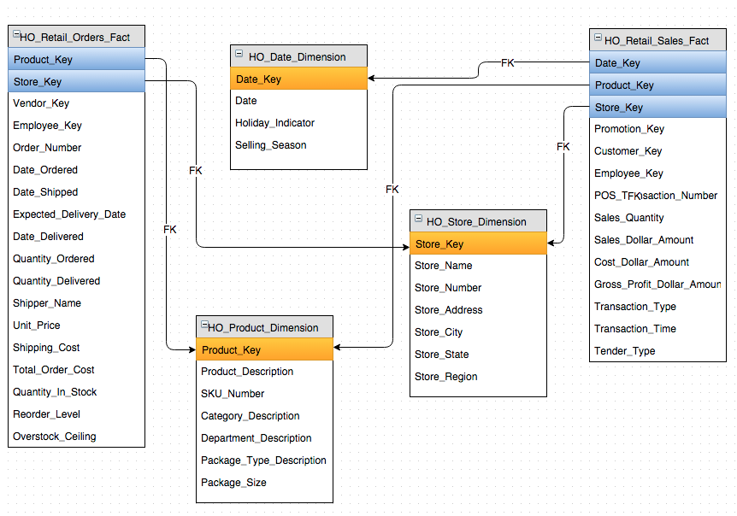
Make a Schema Diagram (recommended)
Look at the data and make note of:
Table and column names
Primary keys and Foreign keys
Data Types
Schema diagramming tools:
draw.io (Google Drive extension)
Visio
Powerpoint
Look for:
Many to Many relationships
Chasm Traps
Circular Relationships (not allowed)

Slide 60
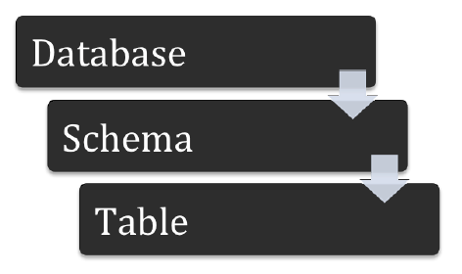
Create the DDL Script
Before loading data, you must create a schema to receive it.
Database
CREATE DATABASE retail;
use retail;
Schema (optional)
Best practice: use the default schema
With a custom schema you need to use <schemaname>.<objectname>
Table
CREATE TABLE orders …
Notes:
Explain why HO
”use retail” is indicating that for all subsequent sql script, use the retail database
We’ll issue a bunch of statements that create tables
You can also create schema, but we have a default schema that is used for compatability. (then don’t need full name)

Slide 61
Create the Schema

Slide 62
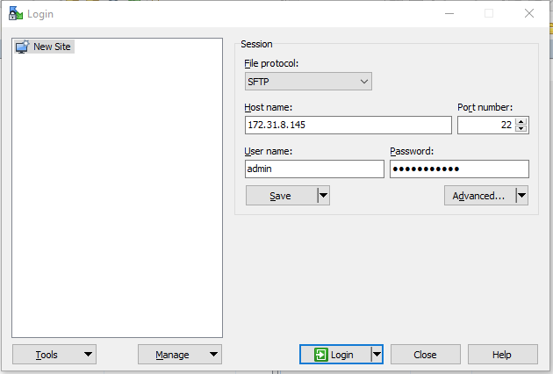
Windows Users: Copy Files to ThoughtSpot with WinSCP
On Windows, you can use WinSCP to copy the file to ThoughtSpot.
Notes:
Let’s create the schema!

Slide 63
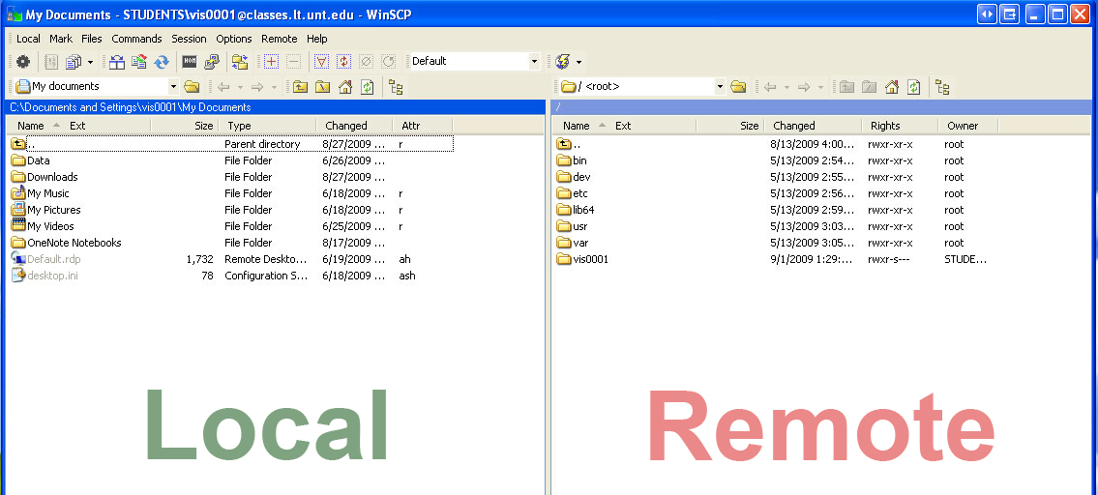
Windows Users: Copy Files to ThoughtSpot with WinSCP
On Windows, you can use WinSCP to copy the file to ThoughtSpot.

Slide 64
Mac Users: Copy Files to ThoughtSpot Using scp
Launch iTerm or another terminal emulator.
Change directories to where you downloaded the file:
cd Downloads
Copy the ZIP file to your cluster using scp.
scp HO_retail_4.4.zip admin@<cluster_IP>:/export
Answer “yes” to the security question.
Enter the ThoughtSpot admin user password when prompted.

Slide 65
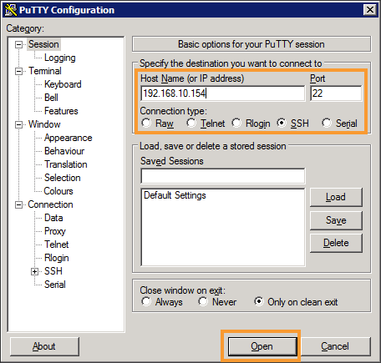
Create the Schema
Log in to the shell:
On Windows:
Use Putty or another SSH client.
Connect to your cluster’s IP address using SSH (port 22)
On Mac or Linux:
Use iTerm or another terminal emulator.
Issue the command: ssh admin@<cluster_IP>

Slide 66
Create the Schema
Find the file you copied over and unzip it:
Navigate to the directory where you copied the ZIP file: cd /export
List the directory contents: ls
Unzip the file: unzip HO_retail_4.4.zip

Slide 67
Create the Schema
Change to the directory created by unzipping: cd HO_retail_4.4
Find the SQL script and take a look at it:
cat retail_ddl.sql
7. Run the script by piping it to TQL:
cat retail_ddl.sql | tql

Slide 68
Create the Schema
Check that the schema was created using TQL:
tql
tql> show databases;
tql> use HO_retail;
tql> show tables;

Slide 69
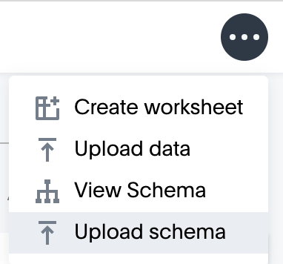
Alternative Method: Import the Schema*
Open ThoughtSpot in a browser.
Click on Data.
Click the three dot icon, and choose Upload Schema.
* Use this method when you do not have scp
or shell access to ThoughtSpot

Slide 70
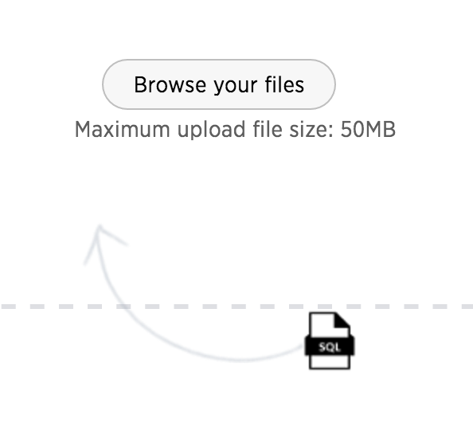
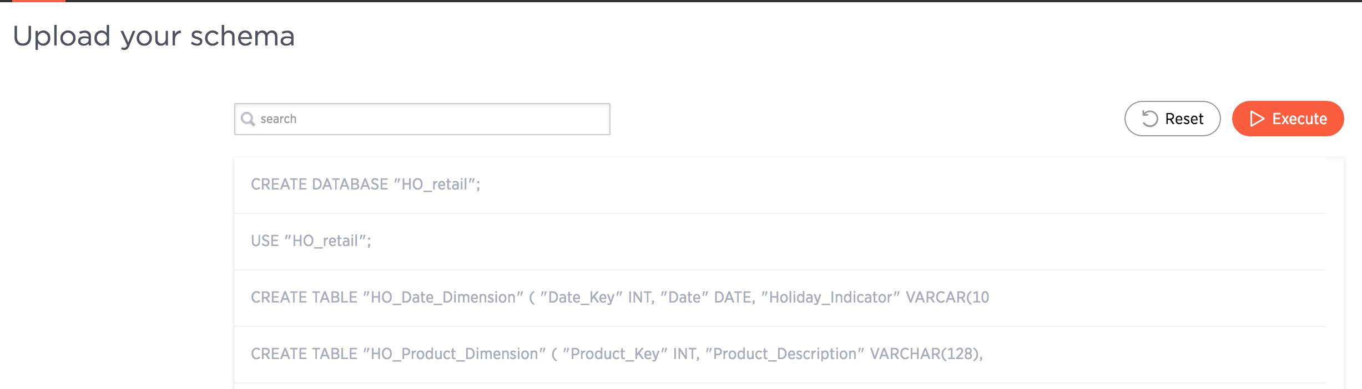
Alternative Method: Import the Schema*
Drag and drop or browse to select the file retail_ddl.sql.
Click Execute.

Slide 71
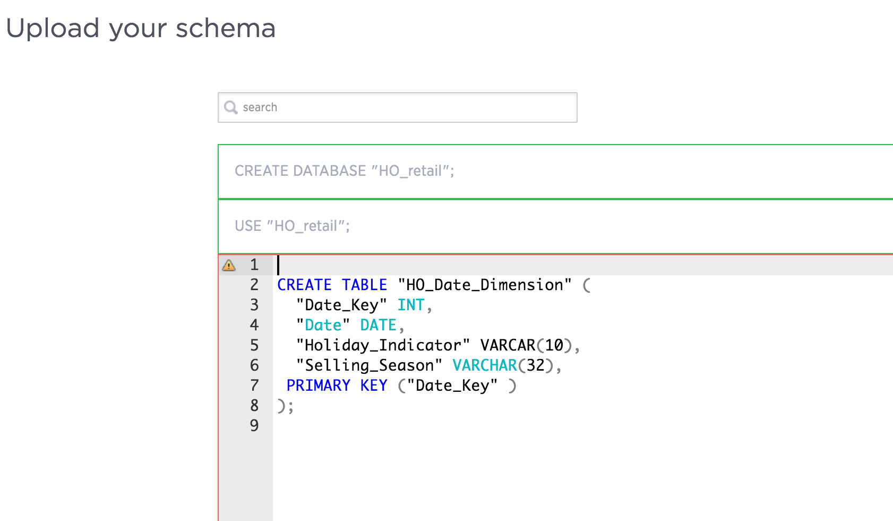
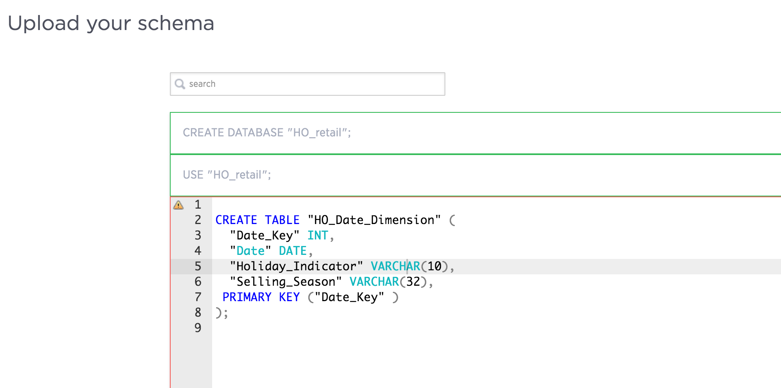
Alternative Method: Import the Schema*
If errors are found, correct them.

Slide 72
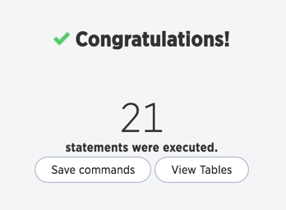
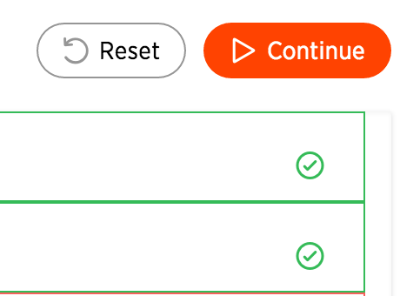
Alternative Method: Import the Schema*
Click Continue to resume execution.
Save commands will download new file with your changes.
View Tables to see the tables you created.

Slide 73
Load Data

Slide 74
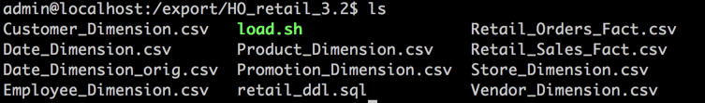
Load the Data
Log in to the shell
Find the directory you copied over: cd /export/HO_retail_4.4
Look at the files that are in that directory:
ls
Notes:
If, for example, you save the HO_retail_3.2.zip file to Desktop, you need to be in the Desktop directory in order to scp.

Slide 75
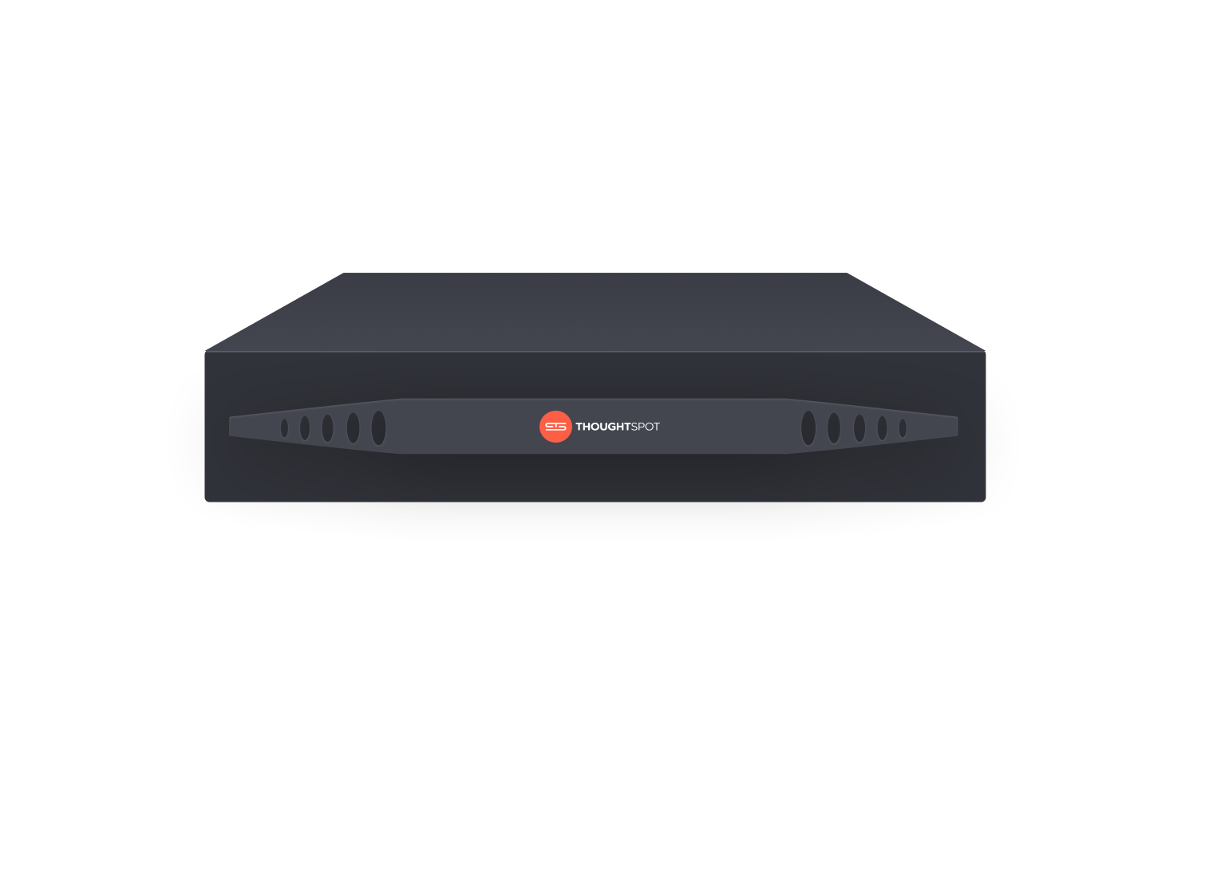
Load the Retail Data
Open the loading shell script, and look at what it contains: cat load.sh
CSV
Notes:
cd to HO_retail_3.3, then ls to see that the loading script is there (in green)

Slide 76
Load the Retail Data
Run the script to load the data:
./load.sh
Review the loading messages.
Check the load in TQL:
SELECT COUNT(*) from HO_Retail_Sales_Fact;
Notes:
cd to HO_retail_3.3, then ls to see that the loading script is there (in green)

Slide 77

Date Flags
Other flags for dates:
--skip_second_fraction
--format_file
Provide a JSON file with date formats per column, if they’re different
Notes:
cd to HO_retail_3.3, then ls to see that the loading script is there (in green)

Slide 78
Parallel Loading
If you have a data file with over 50 million rows
. . . you can run tsload with multiple threads for faster load times:
Split the large data file into multiple smaller files (between 2 and 5).
Create a script to load the files.
Make your script multi-threaded by invoking multiple loader threads
(between 1 and 5 are recommended).
CSV
CSV
CSV
Notes:
You also have ability to to do parallel loading.
You could split your file into multiple csv files if it’s very large and you want it to load faster, it’s recommended between 2 and 5 files to load in parallel. You should know it’s possible, and there is documentation on this.

Slide 79

Alternative Method: Load the Data*
Click DATA, and click on the table you want to load data into.
Click Load Data. (Files must be 50MB or less with this method).
* Use this method when you do not have scp or shell access to ThoughtSpot

Slide 80

Alternative Method: Load the Data
Upload the CSV file with the data.
Select the options at the bottom of the screen.
Click Next.

Slide 81

Alternative Method: Load the Data
Preview the data, then click Upload.

Slide 82
Verify Schema and Data Load

Slide 83


View the Schema
Click the three dot icon and View Schema.
Click on Data.

Slide 84

View the Schema
View the schema.

Slide 85

Check the Data Load
Click the Data tab
Check the sample values to make sure they are correct.

Slide 86
Monitoring your database

Slide 87

Control Center
You can view the Control Center by clicking on Admin and then clicking System Health.
Explore the different reports there about usage, alerts, and cluster health.
Notes:
We have a whole section on this later, but I want to direct you where monitoring is visible in TS
Admin > System Health shows system pinboards which are being populated automatically as TS is being used

Slide 88
Saving your database

Slide 89
Snapshots and Backups
ThoughtSpot can save your work using snapshots and backups. Consider doing a snapshot or backup before or after any major changes, not just periodically.
Snapshots
Purpose is to restore cluster to particular point in time
Very fast (couple of minutes)
Potential to impact users since they cannot save during snapshots
Subject to loss after upgrade or disk failure
Stored in HDFS
Backups
Materialized snapshots
Slower due to I/O
Does not impact users
Can restore after upgrade or on another cluster
3 types: Full, lightweight, dataless
Stored outside the cluster on either local or NAS disk
Notes:
TS takes periodic snapshots every so often (you can configure how often). The Snapshots happen quickly, they’re transparent to end user, and they get stored in HDFS.
Sometimes you want to pull the snapshot into a backup. If you’re changing the schema and you have a backup in case you mess something up. Also take a backup before you do an update. Taking a backup doesn’t affect the end user; it’s just materializing the snapshot. There are 3 types of backups:
Full includes all data
Lightweight backup includes the metadata but not the data (confirm)
Dataless (schema only, no data)
Dataless backup is smaller but to rebuild the cluster you need to reload the data; it hast he structure of the objects but not data, you still need to load data. But if you are having trouble with TS and you think it’s a problem with the schema, you can send the dataless backup to TS and they can test it , you can share your instance without any of the data.
Full: also has release tarball so the cluster can be fully restored (?)
Lightweight: Like dataless but also includes data loaded through the front end
Dataless: Only metadata and schema
Snaphot is in HDFS, and a backup is a snapshot that’s turned into linux
A snapshot is a timestamped image of your live cluster that you can use to restore that cluster. You can with work snapshots through the tscli interface.
A backup is a procedure that stores a snapshot outside of a ThoughtSpot cluster. You can use a backup to restore a cluster to a prior state, a differently configured appliance, or move it to from an appliance to a virtual cluster or vice versa. Other advanced administrative operations also use backups.
https://docs.thoughtspot.com/6.0/admin/backup-restore/choose-strategy.html

Slide 90
Create a snapshot and backup
First, create a snapshot:
$ tscli snapshot create training “Snapshot to save training model and data.” 1
$ tscli snapshot ls
View the snapshots and see how large different backups will be.
Create a backup from the snapshot:
$ tscli backup create training ./training
Monitor progress. You should see a success message.
To see the size of the backup folder: $ du –sh ./training
Notes:
The way to create them are these commands. This will be moving to the administrator interface, coming shortly but currently you need these commands. It’s in the documentation.

Slide 92
Toolkit

Slide 93



Most basic tools for working with CSV files
Text editor (VSCode, BBEdit, Atom, Sublime Text, TextWrangler, or similar)

Slide 94

Most basic tools for working with CSV files
Microsoft Excel

Slide 95
Linux commands
You might need the “dos2unix command” - but it’s rare
Use sed if you want to split a large file into multiple smaller files.
For example:
$ cat “$file” | sed -e ‘1 s/^\xef\xbb\xbf//’ | iconv -f CP1250 -t UTF-8 | tail -n +2 | tsload …

Slide 96
Linux “cut” command
Easy way to remove columns from a CSV data file.
This command creates a new file with just columns 1, 2, 19, and 21 from the source file:
$ cut -d'|' -f1,2,19,21 Date_Dimension_orig.csv > Date_Dimension.csv

Slide 97

Public scripts and resources
https://github.com/thoughtspot/community-tools

Slide 98

Data Generator
Use a data generator to create fake data for a demo or testing.
You can generate your own data here: http://generatedata.com/

